Slide 1
بسم الله الرحمن الرحيم
وَقُلِ ٱعْمَلُواْ فَسَيَرَى ٱللَّهُ عَمَلَكُمْ وَرَسُولُهُۥ وَٱلْمُؤْمِنُونَ ۖ
صدق الله العظيم

Slide 2
MILITARY TECHNICAL COLLEGE
Ph.D. Final Defense
ELECTRICAL ENGINEERING BRANCH
Wireless and Cybersecurity
Enhancing IoT Security with Blockchain and
Machine learning
By
Capt. Eng. Ammar Ibrahim
Supervisors
Maj. Gen. Dr. Prof. Ashraf D. Elbayoumy
Col. Dr. Mohamed Hussein
Col. Dr. Mahmoud K. M. Abdelaziz

Slide 3
Introduction | Proposed System Architecture | Attack model | Machine learning model | Blockchain integration | Application Examples | Contributions | Conclusion
Outline
MILITARY TECHNICAL COLLEGE
Introduction
Proposed System Architecture
Attack model
Machine learning model
Blockchain integration
Application Examples
Contributions
Conclusion

Slide 4
Introduction | Problem Statement | Literature Review | Research Gap | Motivation
Outline
MILITARY TECHNICAL COLLEGE
Introduction
Problem Statement
Literature Review
Research Gap
Motivation

Slide 5

Introduction | Problem Statement | Literature Review | Research Gap | Motivation
Introduction(1/3)
MILITARY TECHNICAL COLLEGE
A Connected World
Imagine a World Where Everything is Connected…
Notes:
"The increasing integration of IoT devices into daily operations has raised serious security concerns—especially regarding DDoS attacks, which can disrupt entire networks with overwhelming traffic. Traditional countermeasures often rely on centralized infrastructure, which is unsuitable for IoT environments due to scalability and trust limitations.
In this work, we explore how combining Machine Learning for anomaly detection with Blockchain for decentralized trust can provide a more resilient and scalable solution."

Slide 6
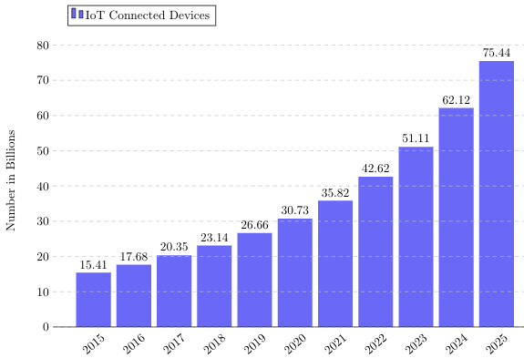
Introduction | Problem Statement | Literature Review | Research Gap | Motivation
Introduction(2/3)
MILITARY TECHNICAL COLLEGE
It’s not the future, it’s now.
But with great connectivity comes a hidden threat.
IoT: Number of devices worldwide from 2015 to 2025 ‏
Notes:
"The increasing integration of IoT devices into daily operations has raised serious security concerns—especially regarding DDoS attacks, which can disrupt entire networks with overwhelming traffic. Traditional countermeasures often rely on centralized infrastructure, which is unsuitable for IoT environments due to scalability and trust limitations.
In this work, we explore how combining Machine Learning for anomaly detection with Blockchain for decentralized trust can provide a more resilient and scalable solution."

Slide 7
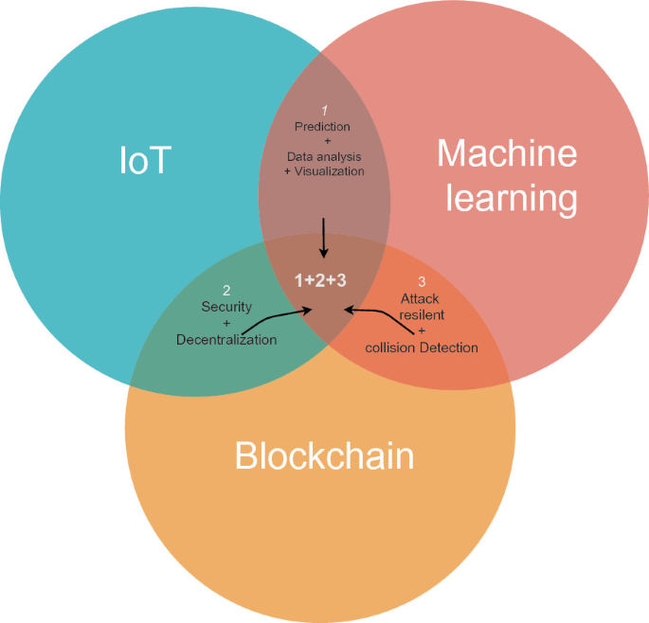
Introduction | Problem Statement | Literature Review | Research Gap | Motivation
Introduction(3/3)
MILITARY TECHNICAL COLLEGE
DDoS attacks can disrupt entire networks with massive traffic floods.
This work proposes a solution based :
1- Machine Learning for lightweight anomaly detection
2- Blockchain for decentralized management
Together, they offer a scalable and resilient IoT security framework.
Towards Integration of Blockchain and Machine Learning Technologies for Security in Smart Cities*
Notes:
"The increasing integration of IoT devices into daily operations has raised serious security concerns—especially regarding DDoS attacks, which can disrupt entire networks with overwhelming traffic. Traditional countermeasures often rely on centralized infrastructure, which is unsuitable for IoT environments due to scalability and trust limitations.
In this work, we explore how combining Machine Learning for anomaly detection with Blockchain for decentralized trust can provide a more resilient and scalable solution."

Slide 8
Introduction | Problem Statement | Literature Review | Research Gap | Motivation
Outline
MILITARY TECHNICAL COLLEGE
Introduction
Problem Statement
Literature Review
Research Gap
Motivation

Slide 9

Introduction | Problem Statement | Literature Review | Research Gap | Motivation
Problem Statement(1/3)
MILITARY TECHNICAL COLLEGE
Problems :
🔐 Problem 1: Systemic Credential Vulnerabilities in IoT Devices Numbers:
Empirical Evidence: Symantec (2016)* identified that approximately
of IoT devices utilize easily guessable credentials, enabling direct exploitation without requiring advanced hacking techniques.
70%
Mirai Botnet Case Study
The Mirai botnet, disruptive DDoS campaigns in 2016, infected over
devices impacting online platforms including Twitter and Netflix (Antonakakis et al., 2017)*.
500,000 +
Antonakakis, M., et al. (2017). Understanding the Mirai Botnet. USENIX Security Symposium.
Symantec. (2016). Internet Security Threat Report.
Notes:
Problem 2.2.1
Problem 2.2.2
Problem 2.2.3

Slide 10
Introduction | Problem Statement | Literature Review | Research Gap | Motivation
Problem Statement(2/3)
MILITARY TECHNICAL COLLEGE
Problems :
🧱 Problem 2: Architectural Incompatibility of Traditional Security Models
Security Implications:
1- Single points of failure
2- Bottlenecks: Reducing resilience against coordinated DDoS
.
Statistical: Kaspersky (2022)* reported a
surge in IoT-targeted DDoS attacks
Inefficacy of countermeasures in dynamically scaled environments.
62%
Notes:
Problem 2.2.1
Problem 2.2.2
Problem 2.2.3

Slide 11
Introduction | Problem Statement | Literature Review | Research Gap | Motivation
Problem Statement(3/3)
MILITARY TECHNICAL COLLEGE
Problems :
🔋 Problem 3: Energy and Computational Constraints
The lightweight sensors are expected to function autonomously for 1–2 years, yet power-intensive updates reduce their operational span to mere weeks (Mosenia & Jha, 2017)*.
Mosenia, A., & Jha, N. K. (2017). A Comprehensive Study of Security of Internet-of-Things. IEEE Transactions on Emerging Topics in Computing.
Notes:
Problem 2.2.1
Problem 2.2.2
Problem 2.2.3

Slide 12
Introduction | Problem Statement | Literature Review | Research Gap | Motivation
Outline
MILITARY TECHNICAL COLLEGE
Introduction
Problem Statement
Literature Review
Research Gap
Motivation

Slide 13
Introduction | Problem Statement | Literature Review | Research Gap | Motivation
Literature Review (1/3)
MILITARY TECHNICAL COLLEGE
The rapid growth of IoT ecosystems has introduced major security concerns, particularly Distributed Denial of Service (DDoS) attacks. Many researchers proposed Machine Learning (ML)–based techniques for DDoS detection, but several critical limitations remain:
Two Critical Limitations in IoT Security Systems
1. Computational Overhead Advanced machine learning models—such as deep neural networks and complex classifiers—often require processing power and memory beyond the capabilities of typical IoT devices. 📉 Consequences: Performance degradation, frequent system crashes, and increased false negatives at the network edge.(Ahsan et al., 2024; Shirvani et al., 2024)
2. Excessive Energy Consumption Centralized or cloud-based detection frameworks rely heavily on continuous data transmission, which rapidly depletes the limited battery reserves of IoT sensors. 🔋 Consequences: Reduced device lifespan and higher operational costs due to frequent maintenance. (Cui et al., 2022; Bai et al., 2024)
Without LIGHTWEIGHT, ENERGY-EFFICIENT detection, IoT security remains fundamentally UNSUSTAINABLE.
Notes:
Problem 2.2.1
Problem 2.2.2
Problem 2.2.3

Slide 14
Introduction | Problem Statement | Literature Review | Research Gap | Motivation
Literature Review (2/3)
MILITARY TECHNICAL COLLEGE
Two Fundamental Security Challenges
1. Vulnerability to Insider Threats Centralized trust architectures remain highly susceptible to manipulation and insider attacks. A single compromised authority can jeopardize the integrity of the entire network. ⚠️ Consequence: Network-wide breaches stemming from one malicious or compromised node.(Jmal et al., 2023)
2. The Security-Efficiency Trade-off Emerging decentralized solutions—such as blockchain and federated learning—offer theoretical resilience but often face a critical trade-off between robustness and performance. ⚖️ Consequence: Increased latency, resource overhead, and unresolved trust issues among participating entities. (Alzoubi, 2024; Bai, 2024; Shirvani, 2024)
Notes:
Problem 2.2.1
Problem 2.2.2
Problem 2.2.3

Slide 15
Introduction | Problem Statement | Literature Review | Research Gap | Motivation
Literature Review (3/3)
MILITARY TECHNICAL COLLEGE
#. | Title | Model(s) | Dataset | #Features (FS method) | Blockchain Method | Accuracy | Blockchain Node Roles
[1] | Collaborative Threat Intelligence in IoT | Random Forest, SVM | IoT23 | 25 (MI + RFE) | Permissioned PBFT network | 98.6 % | Validators: run consensus and append blocks; Clients: submit transactions
[2] | Federated Learning for DDoS Defense in IoT | Federated CNN | NSL-KDD | 41 (Filter by correlation) | Public Ethereum smart contracts | 97.4 % | Miners: validate blocks; Workers: train local models
[3] | Correlation-Aware Neural DDoS Detection | LSTM, Transformer | Synthetic IoT (4 060 nodes) | 10 (mutual information) | Hyperledger Fabric channel | 99.1 % | Peers: endorse and commit transactions; Orderers: sequence blocks
[4] | Blockchain-SDN Secure IoT with ANN | ANN | SDN-IoT | 15 (embedded weights magnitude) | Private chain with voting | 96.8 % | Authorities: vote consensus; Sensors: feed data and receive commands
[5] | Blockchain-Assisted Intrusion Detection in Smart Cities | Decision Tree, KNN | KDD-Cup ’99 | 41 (PCA) | Consortium Corda network | 95.3 % | Notaries: manage consensus; Nodes: store ledger
[6] | Privacy-Enhanced Federated Learning for IoT Anomaly Detection | Autoencoder FL | UNSW-NB15 | 49 (autoencoder-based FS) | Ethereum private network | 94.7 % | Validators: verify FL updates; Clients: local data owners
[7] | Blockchain-Enabled Collaborative Anomaly Detection | SVM | CICIDS2017 | 78 (None; full set) | PBFT with multi-tier nodes | 98.2 % | Primary nodes: propose blocks; Backup nodes: confirm blocks
[8] | HBFL: Hierarchical Blockchain-Federated Framework for IoT IDS | Federated MLP | Bot-IoT | 35 (recursive elimination) | Hyperledger Sawtooth | 97.0 % | Root nodes: anchor model; Edge nodes: local aggregation
[9] | Hybrid CNN-LSTM-Autoencoder for IoT DDoS Detection | CNN, LSTM, Autoencoder | Custom smart-grid IoT | 20 (SMOTE + mutual information) | Multi-chain PBFT | 99.3 % | Consensus nodes: finalize state; Client nodes: data providers
Notes:
Problem 2.2.1
Problem 2.2.2
Problem 2.2.3

Slide 16
Introduction | Problem Statement | Literature Review | Research Gap | Motivation
Outline
MILITARY TECHNICAL COLLEGE
Introduction
Problem Statement
Literature Review
Research Gap
Motivation

Slide 17

Introduction | Problem Statement | Literature Review | Research Gap | Motivation
Research Gap
MILITARY TECHNICAL COLLEGE
Identified Research Gap
Current IoT DDoS detection frameworks are hindered by excessive computational complexity and resource overhead.
Lightweight machine learning and blockchain paradigm can deliver scalable, lightweight, efficient, and decentralized attack detection and mitigation.
Critical Missing Element:
Needs for unified framework exists that optimizes both
lightweight anomaly detection
decentralized trust management
Integration of epidemic modeling with ML for DDoS propagation analysis
Specific Gaps Addressed:
Blockchain-based trust scoring for IoT device validation
Lightweight feature selection optimized for overhead reduction
Hybrid architecture balancing centralized efficiency with decentralized resilience
Notes:
Problem 2.2.1
Problem 2.2.2
Problem 2.2.3

Slide 18
Introduction | Problem Statement | Literature Review | Research Gap | Motivation
Outline
MILITARY TECHNICAL COLLEGE
Introduction
Problem Statement
Literature Review
Research Gap
Motivation

Slide 19










Introduction | Problem Statement | Literature Review | Research Gap | Motivation
Motivation
MILITARY TECHNICAL COLLEGE
Motivation :
Innovation Imperative
Research Objectives
Traditional security approaches cannot scale to handle billions of IoT devices while maintaining energy efficiency
Develop lightweight ML models for resource-constrained devices
Smart Cities Revolution
Critical infrastructure depends on secure, resilient IoT networks
Implement decentralized trust mechanisms via blockchain
Novel Approach Required
Model DDoS propagation using epidemic theory
Key Sectors at Risk
Balancing Act
Scientific Contribution
Energy Grid Management
Security
Centralized
unified framework
Healthcare Systems
vs
vs
combining ML anomaly detection with blockchain-based trust management for IoT security
Transportation Networks
Efficiency
Distributed
Public Safety
Vision Statement
To create a paradigm, shift in IoT security by demonstrating that hybrid ML-blockchain architectures can achieve both computational efficiency and decentralized enabling secure smart city deployments at scale.
,
Notes:
Problem 2.2.1
Problem 2.2.2
Problem 2.2.3

Slide 20
Introduction | Proposed System Architecture | Attack model | Machine learning model | Blockchain integration | Application Examples | Contributions | Conclusion
Outline
MILITARY TECHNICAL COLLEGE
Proposed System Architecture

Slide 21
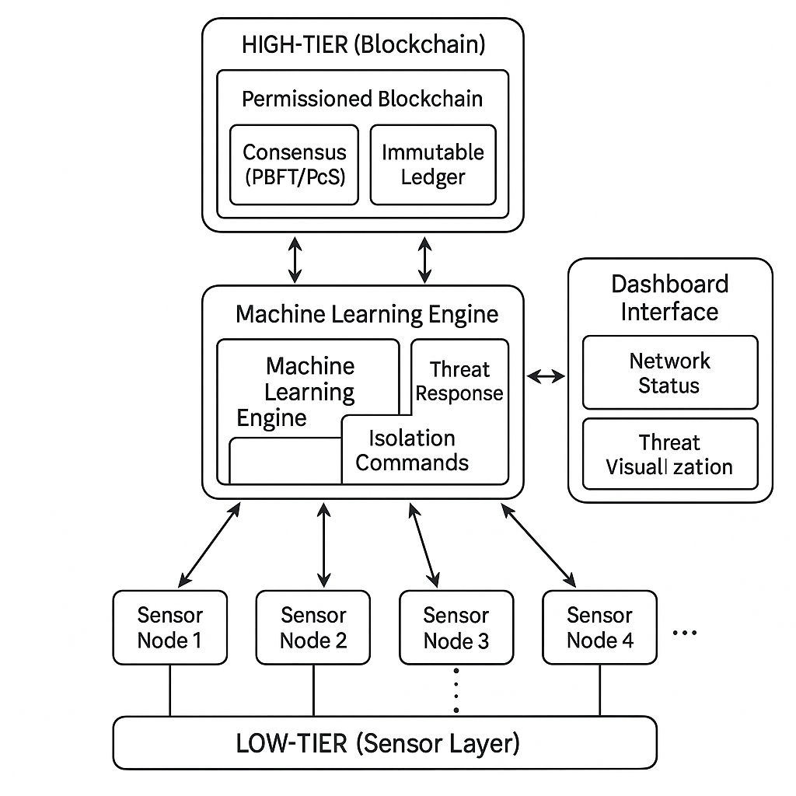
Introduction | Proposed System Architecture | Attack model | Machine learning model | Blockchain integration | Application Examples | Contributions | Conclusion
Proposed System Architecture(basic setup )(1/5)
MILITARY TECHNICAL COLLEGE

Slide 22
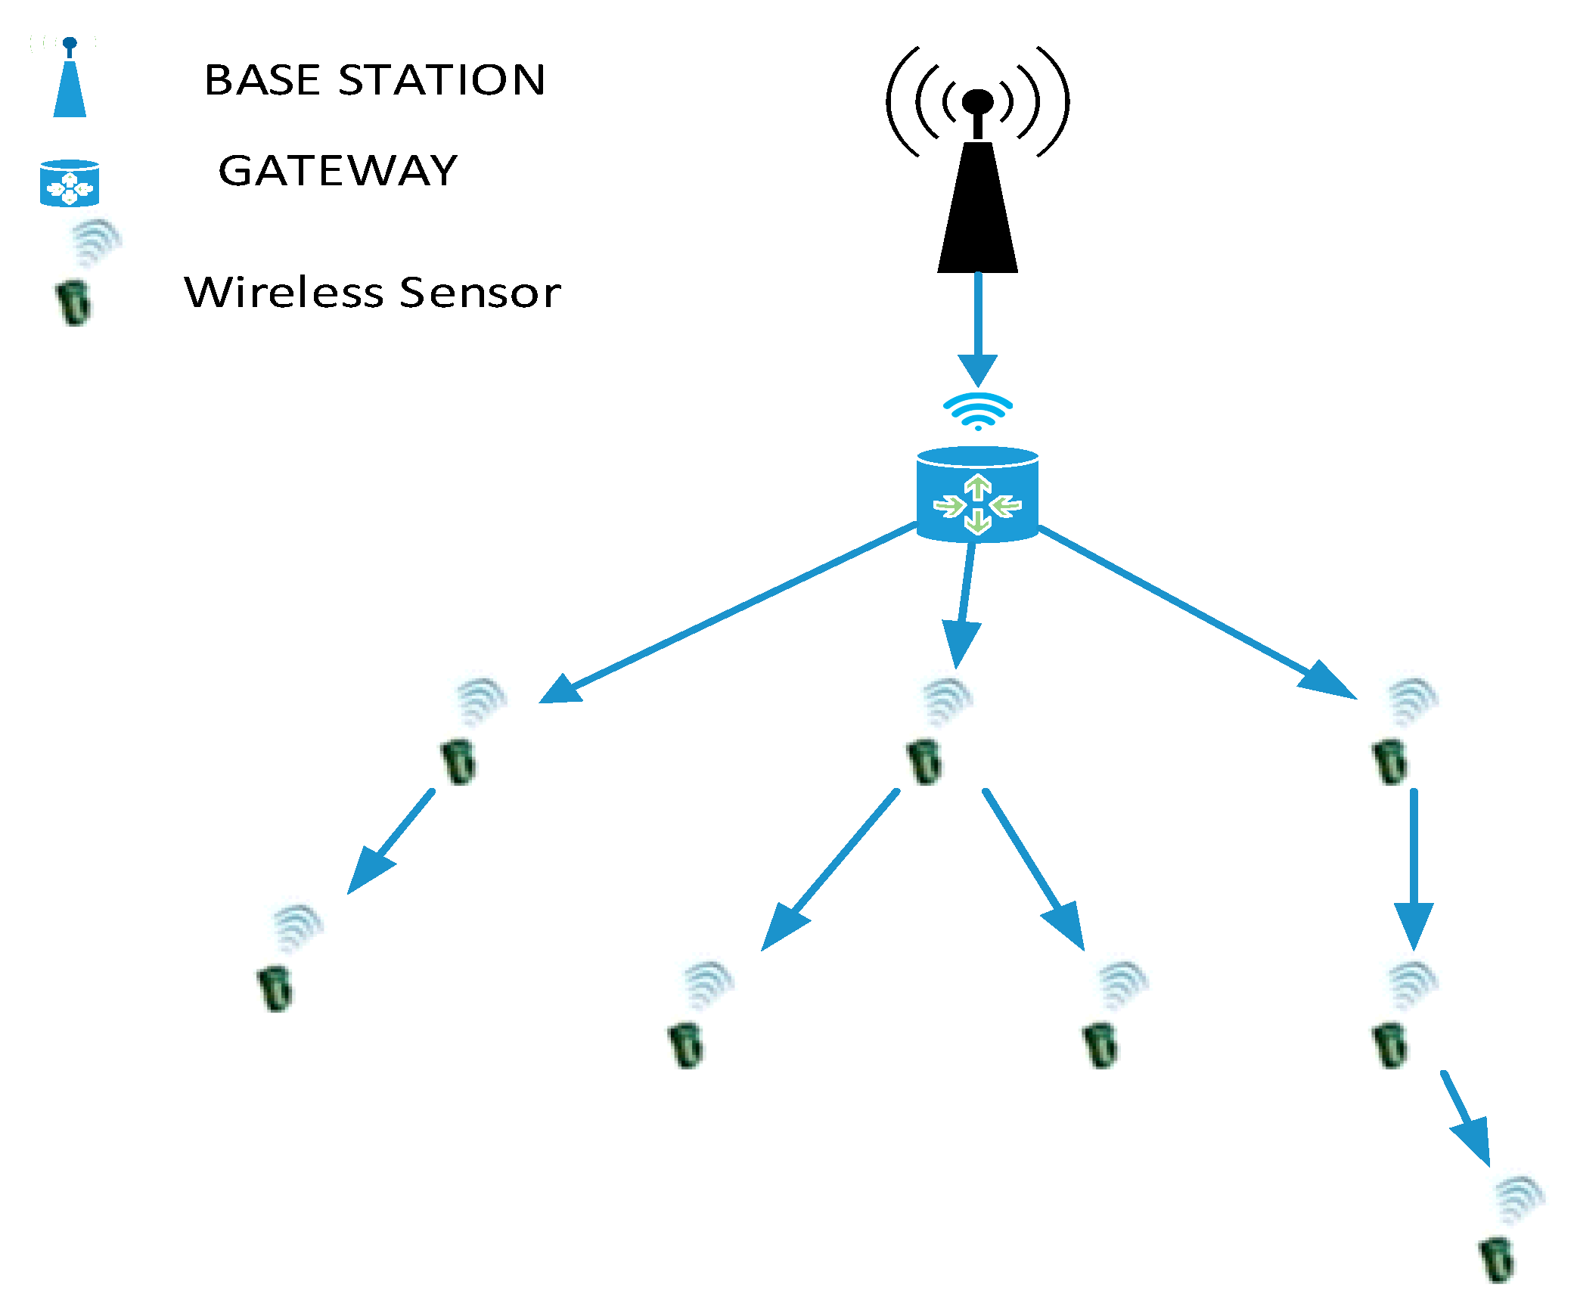
Introduction | Proposed System Architecture | Attack model | Machine learning model | Blockchain integration | Application Examples | Contributions | Conclusion
Introduction | Problem Statement | Literature Review | Research Gap | Motivation | Proposed System Architecture | DDoS Attack Model | Epidemic-Based Mathematical Model (SMEIR)
Proposed System Architecture(basic setup )(2/5)
MILITARY TECHNICAL COLLEGE
Tier | Device Type | Power | Role | Blockchain Role | ML Role
Low-tier | Sensor Node | Very low | Data collection | None | None
Mid-tier | Gateway / Sink Node | Medium | Analysis & relay | Partial | Yes
High-tier | Base Station | High | Ledger management & coordination | consensus | None

Slide 23

Introduction | Proposed System Architecture | Attack model | Machine learning model | Blockchain integration | Application Examples | Contributions | Conclusion
Proposed System Architecture(basic setup )(3/5)
MILITARY TECHNICAL COLLEGE
Tier | Device Type | Power | Role | Blockchain Role | ML Role
Low-tier | Sensor Node | Very low | Data collection | None | None
Mid-tier | Gateway / Sink Node | Medium | Analysis & relay | Partial node, mining allowed | Yes
High-tier | Base Station | High | Ledger management & coordination | Full node, consensus | Not necessary
Phase 1: Data collection & Transmission
Description: IoT devices collect sensor data and transmit it to the gateway.
Responsible Component: IoT Devices (Sensor Nodes)
Key Traits: Low power, no heavy computation.

Slide 24
Introduction | Proposed System Architecture | Attack model | Machine learning model | Blockchain integration | Application Examples | Contributions | Conclusion
Proposed System Architecture(basic setup )(4/5)
MILITARY TECHNICAL COLLEGE
Tier | Device Type | Power | Role | Blockchain Role | ML Role
Low-tier | Sensor Node | Very low | Data collection | None | None
Mid-tier | Gateway / Sink Node | Medium | Analysis & relay | Partial node, mining allowed | Yes
High-tier | Base Station | High | Ledger management & coordination | Full node, consensus | None
Phase 2: Anomaly Detection
Description: A lightweight ML model processes incoming traffic and detects anomalies or DDoS behavior.
Responsible Component: Gateway
Key Traits: Capable of running lightweight ML

Slide 25
Introduction | Proposed System Architecture | Attack model | Machine learning model | Blockchain integration | Application Examples | Contributions | Conclusion
Proposed System Architecture(basic setup )(5/5)
MILITARY TECHNICAL COLLEGE
Tier | Device Type | Power | Role | Blockchain Role | ML Role
Low-tier | Sensor Node | Very low | Data collection | None | None
Mid-tier | Gateway / Sink Node | Medium | Analysis & relay | Partial node, mining allowed | Yes
High-tier | Base Station | High | Ledger management & coordination | Full node, consensus | None
Phase 3: Alert Verification and Recording
Description: Validated malicious activity is written to a blockchain ledger.
Responsible Component: (Base Station \blockchain Miner)
Key Traits: Only base station has mining privileges; maintains decentralized trust.

Slide 26
Introduction | Proposed System Architecture | Attack model | Machine learning model | Blockchain integration | Application Examples | Contributions | Conclusion
Outline
MILITARY TECHNICAL COLLEGE
Attack Model
DDoS Attack Model simulated
DDoS Attack Model Epidemic-Based Mathematical Model (SMEIR)

Slide 27
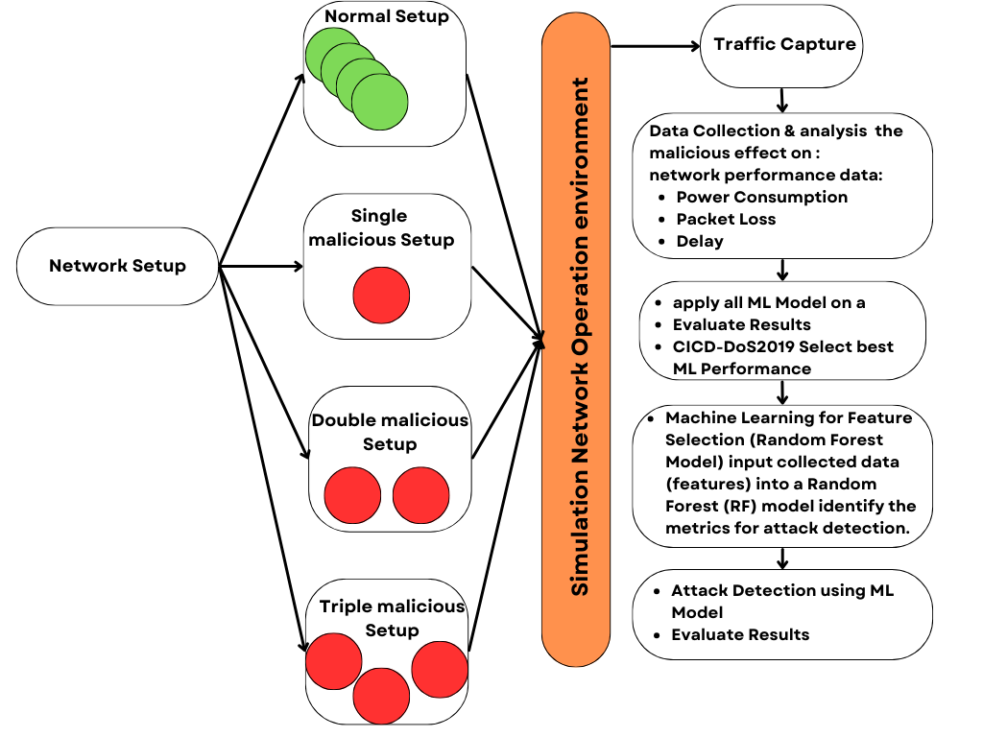
Introduction | Proposed System Architecture | Attack model | Machine learning model | Blockchain integration | Application Examples | Contributions | Conclusion
DDoS Attack Model simulated(1/6)
MILITARY TECHNICAL COLLEGE

Slide 28
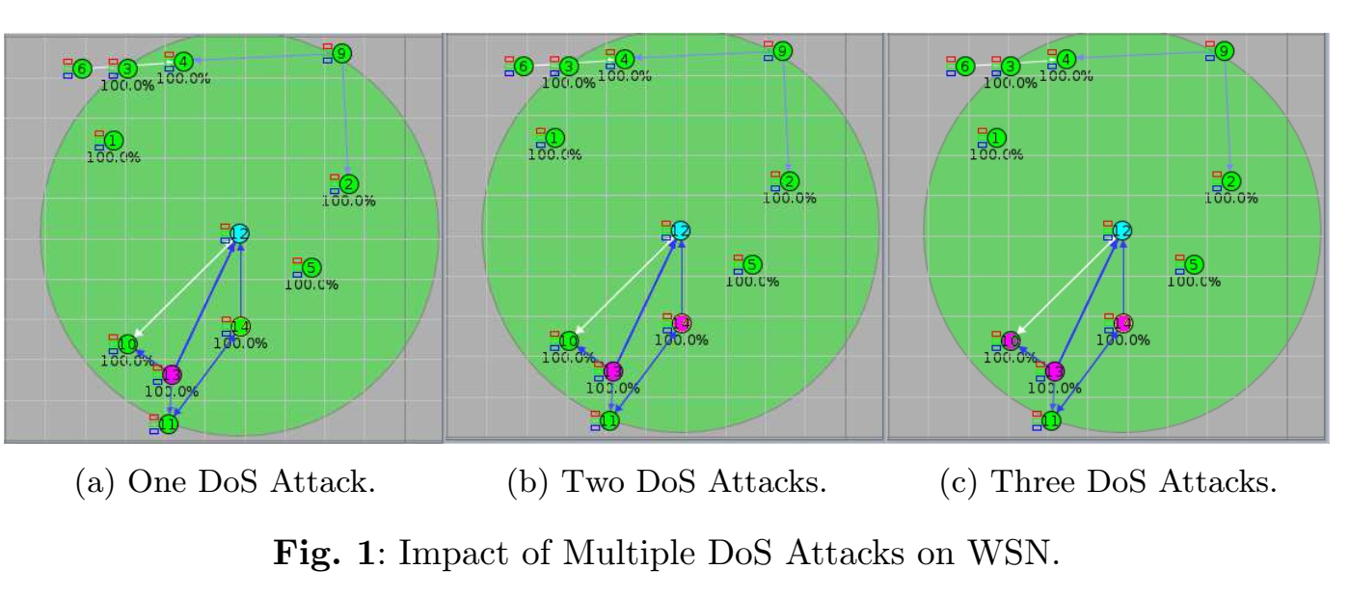
Introduction | Proposed System Architecture | Attack model | Machine learning model | Blockchain integration | Application Examples | Contributions | Conclusion
DDoS Attack Model simulated(2/6)
MILITARY TECHNICAL COLLEGE

Slide 29
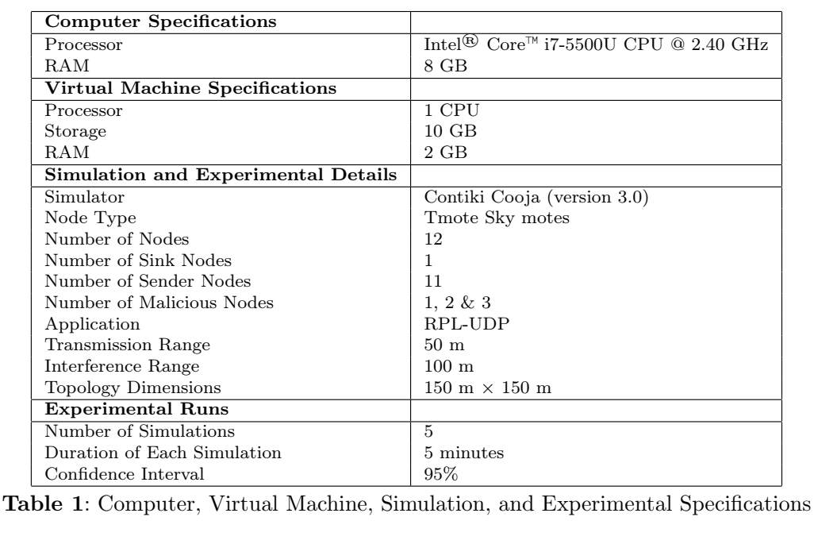
Introduction | Proposed System Architecture | Attack model | Machine learning model | Blockchain integration | Application Examples | Contributions | Conclusion
DDoS Attack Model simulated(3/6)
MILITARY TECHNICAL COLLEGE

Slide 30
Introduction | Proposed System Architecture | Attack model | Machine learning model | Blockchain integration | Application Examples | Contributions | Conclusion
DDoS Attack Model simulated(4/6)
MILITARY TECHNICAL COLLEGE
DDoS attack model dataset analysis
Metric Average score | No Attack | Attack | Double Attack | Triple Attack
Received | 14.0667 | 21.4667 | 8.9333 | 32.2
Lost | 0 | 0.933 | 1.133 | 1.4
Hops | 2.1333 | 2.0947 | 2.6235 | 3.1421
Rtmetric | 665.18 | 1248.6 | 1425.54 | 1872.91
ETX | 28.77 | 43.97 | 56.04 | 65.95
Churn | 0 | 6.467 | 2.2 | 9.7
Beacon Interval | 675331.1 | 12721.07 | 13066.07 | 19081.6
CPU Power | 0.3437 | 0.6296 | 0.6522 | 0.9444
LPM Power | 0.1531 | 0.1444 | 0.1438 | 0.2167
Listen Power | 0.4145 | 1.0914 | 1.2401 | 1.6371
Transmit Power | 0.0621 | 1.1184 | 1.2418 | 1.6776
Power | 0.9734 | 2.9839 | 3.2778 | 4.4758
Listen Duty Cycle | 0.6908 | 1.819 | 2.0668 | 2.7285
Transmit Duty Cycle | 0.1169 | 2.1063 | 2.3386 | 3.1594
Avg Inter-Packet Time | 54951.53 | 59863.4 | 62243.2 | 89795.1
Min Inter-Packet Time | 18933.33 | 17933.33 | 25066.67 | 26900
Notes:
Problem 2.2.1
Problem 2.2.2
Problem 2.2.3

Slide 31
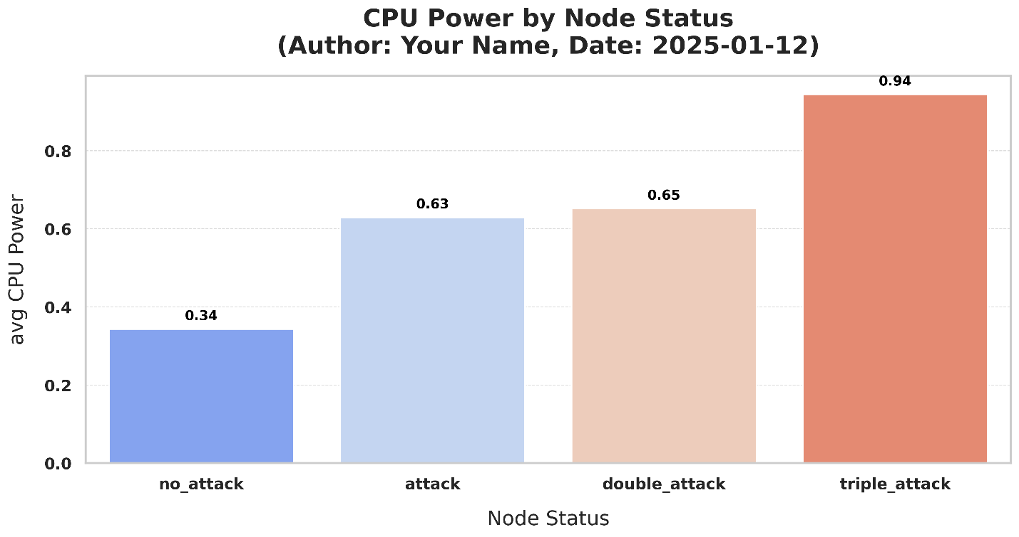
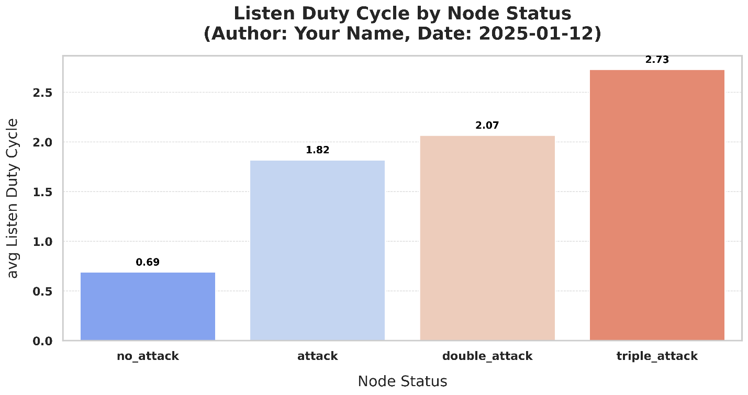
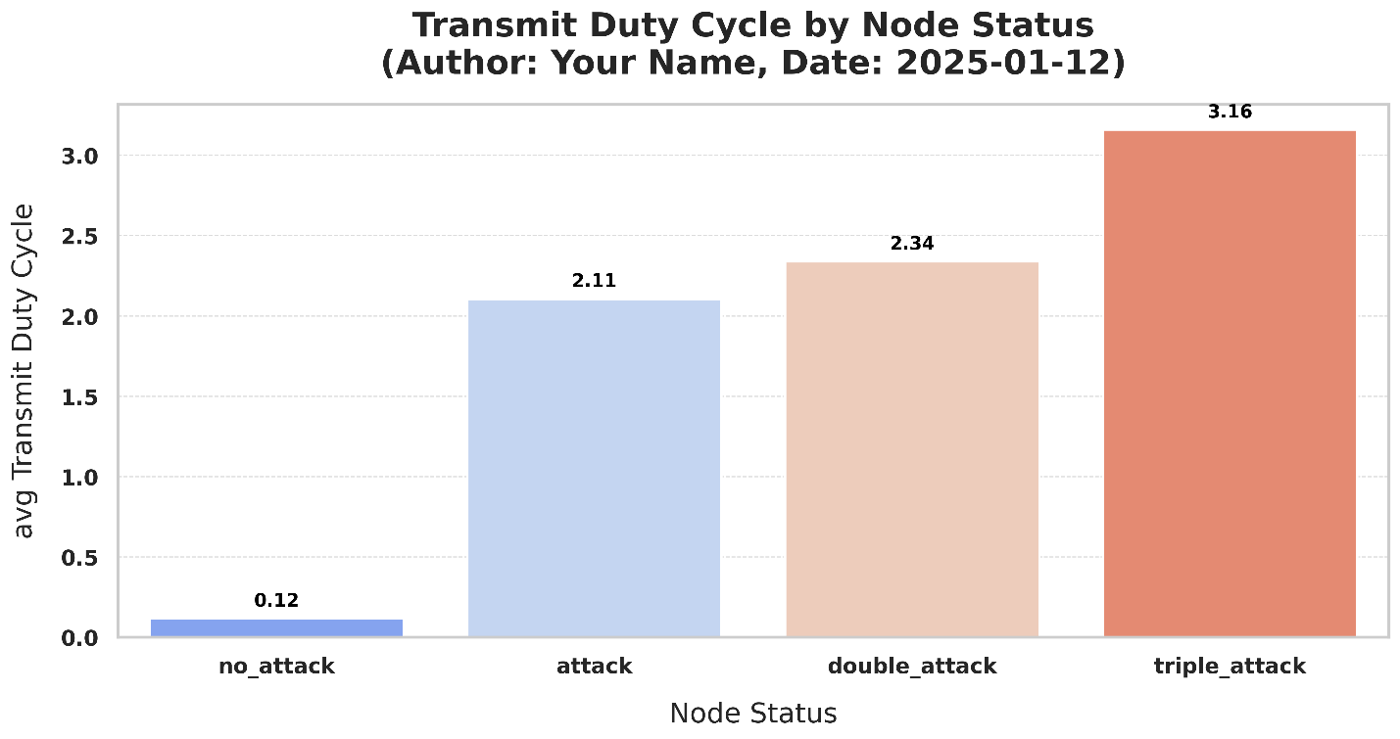

Introduction | Proposed System Architecture | Attack model | Machine learning model | Blockchain integration | Application Examples | Contributions | Conclusion
DDoS Attack Model simulated(5/6)
MILITARY TECHNICAL COLLEGE
DDoS attack model dataset analysis
Notes:
Problem 2.2.1
Problem 2.2.2
Problem 2.2.3

Slide 32
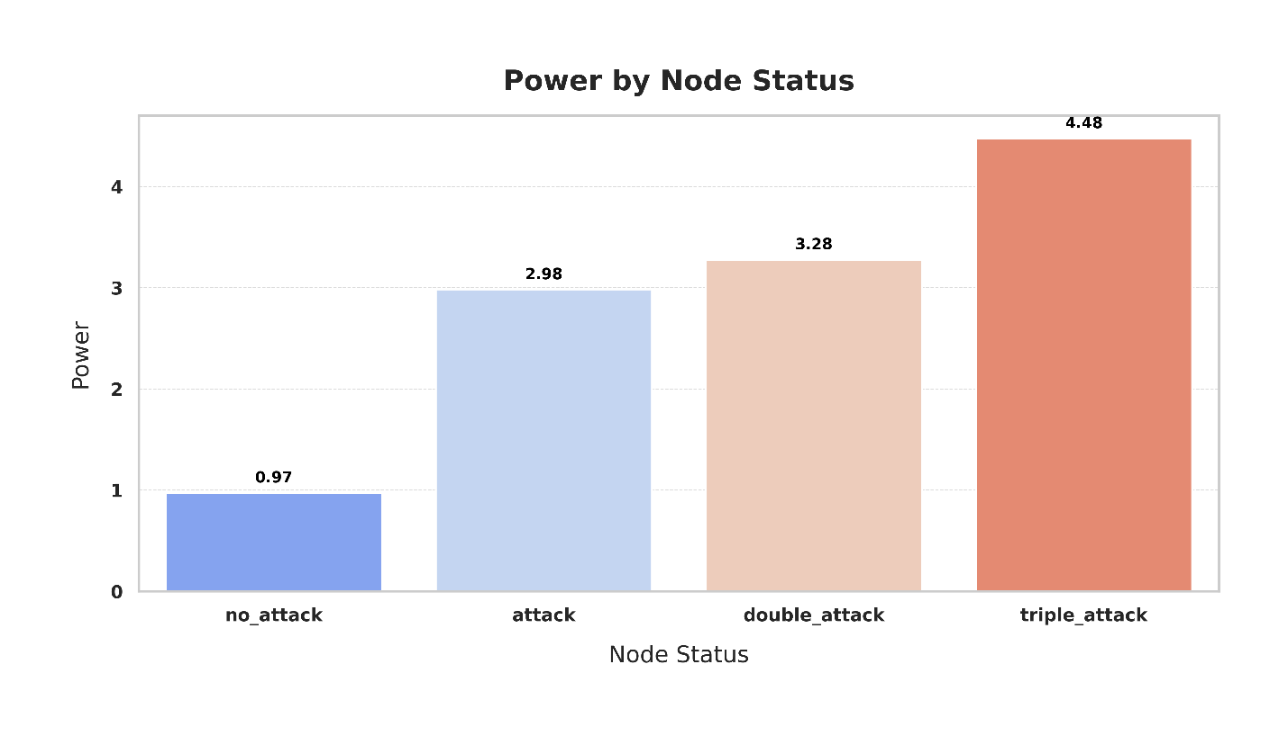
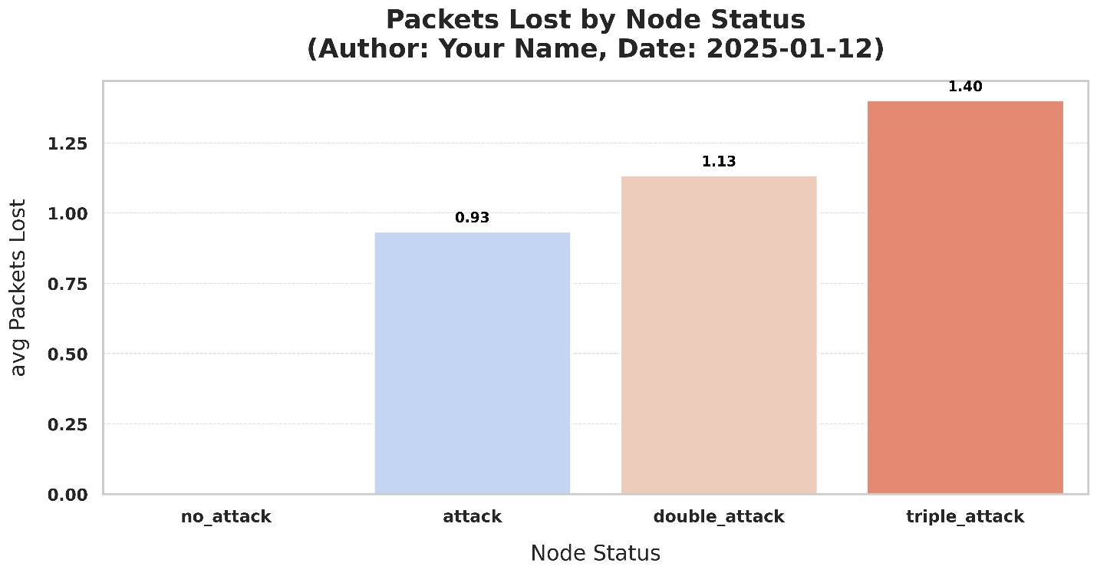
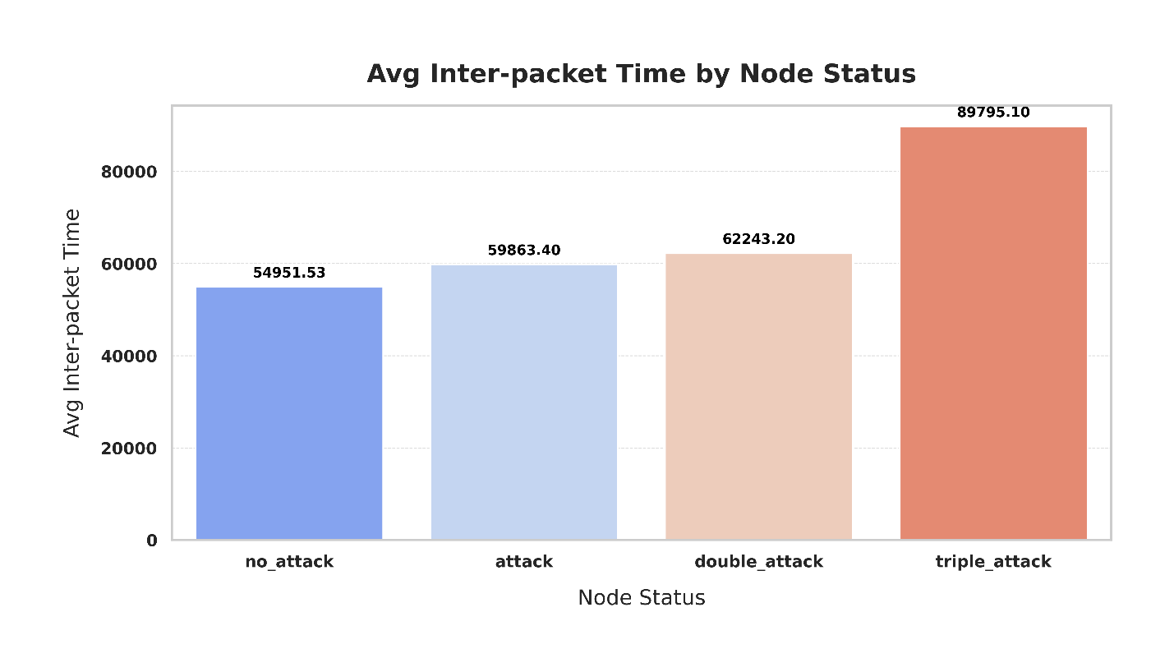
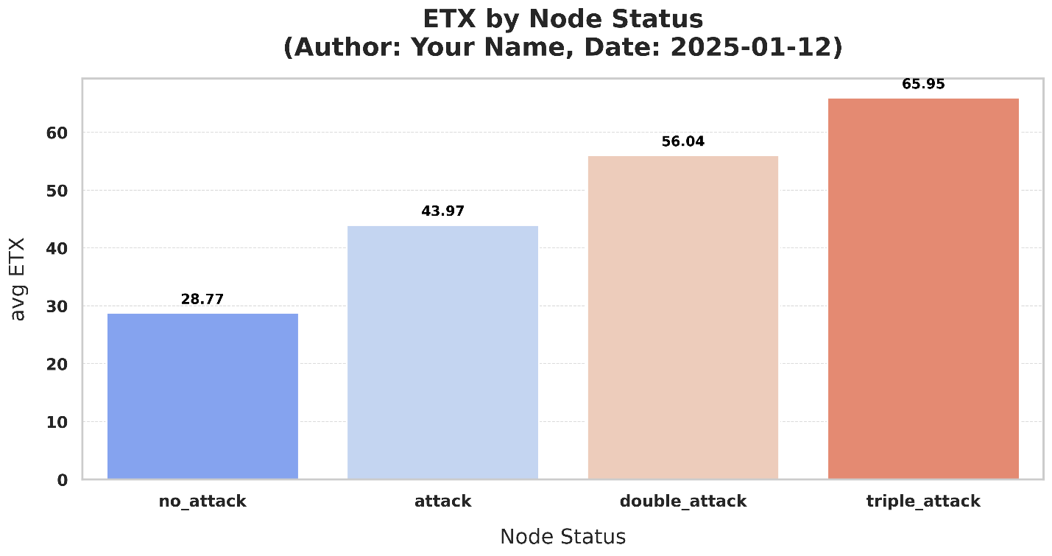
Introduction | Proposed System Architecture | Attack model | Machine learning model | Blockchain integration | Application Examples | Contributions | Conclusion
DDoS Attack Model simulated(6/6)
MILITARY TECHNICAL COLLEGE
DDoS attack model dataset analysis
Notes:
Problem 2.2.1
Problem 2.2.2
Problem 2.2.3

Slide 33
Introduction | Proposed System Architecture | Attack model | Machine learning model | Blockchain integration | Application Examples | Contributions | Conclusion
Outline
MILITARY TECHNICAL COLLEGE
Attack Model
DDoS Attack Model simulated
DDoS Attack Model Epidemic-Based Mathematical Model (SMEIR)

Slide 34
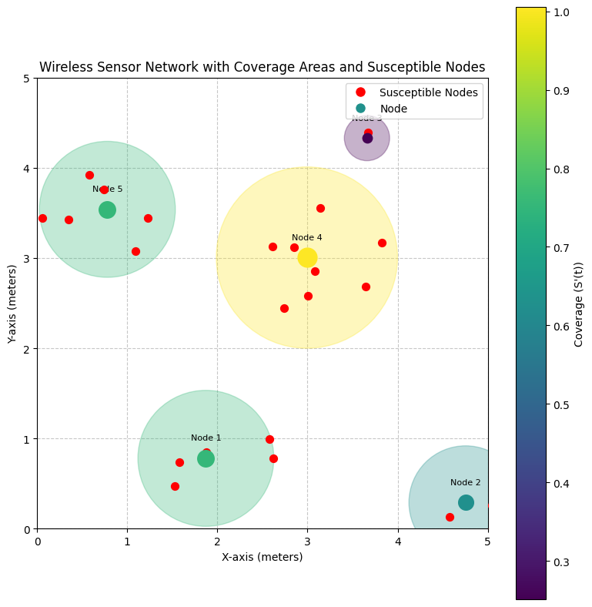
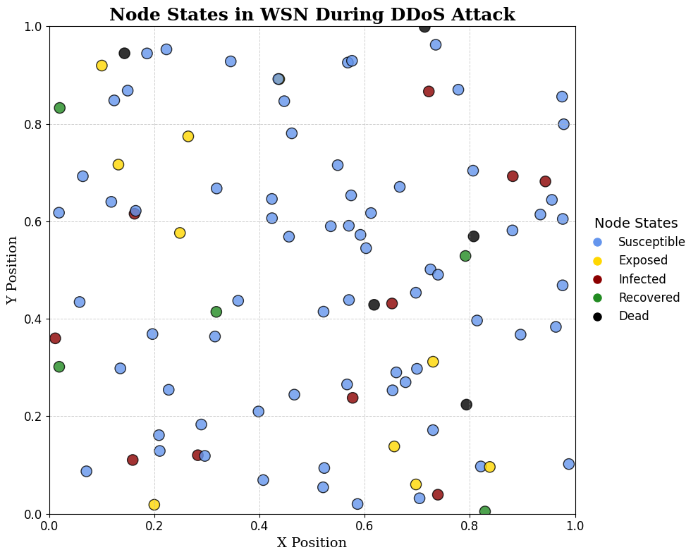
Introduction | Proposed System Architecture | Attack model | Machine learning model | Blockchain integration | Application Examples | Contributions | Conclusion
Epidemic-Based Mathematical Model (SMEIR)(1/13)
MILITARY TECHNICAL COLLEGE

Slide 35
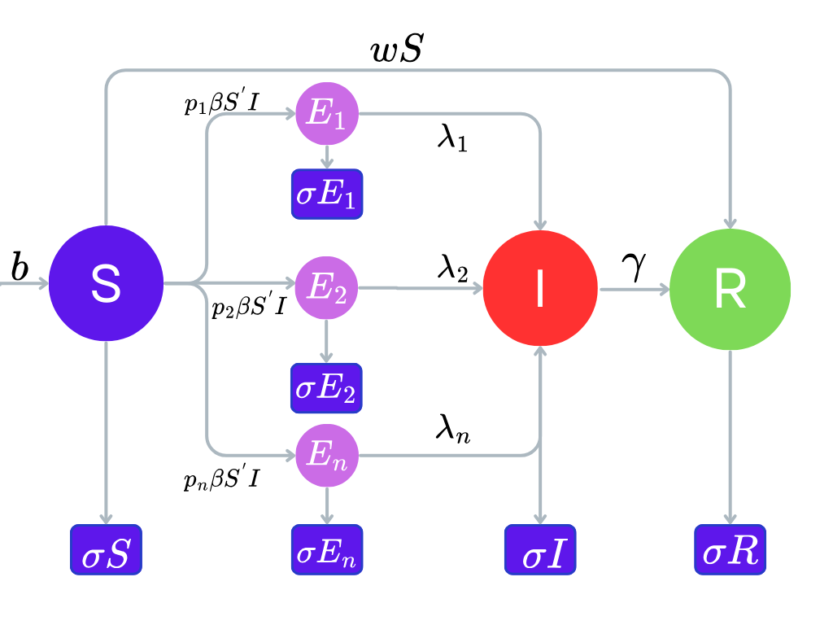
Introduction | Proposed System Architecture | Attack model | Machine learning model | Blockchain integration | Application Examples | Contributions | Conclusion
Epidemic-Based Mathematical Model (SMEIR)(2/13)
MILITARY TECHNICAL COLLEGE
The model state transition diagram.

Slide 36

Introduction | Proposed System Architecture | Attack model | Machine learning model | Blockchain integration | Application Examples | Contributions | Conclusion
Epidemic-Based Mathematical Model (SMEIR)(3/13)
MILITARY TECHNICAL COLLEGE
Susceptible (S): Nodes at risk of a DDoS attack but have not been affected yet.
Notes:
Problem 2.2.1
Problem 2.2.2
Problem 2.2.3

Slide 37
Introduction | Proposed System Architecture | Attack model | Machine learning model | Blockchain integration | Application Examples | Contributions | Conclusion
Epidemic-Based Mathematical Model (SMEIR)(4/13)
MILITARY TECHNICAL COLLEGE
2. Exposed (E): Nodes impacted by the initial stages of a DDoS attack, potentially contributing to its spread. Includes types E1, E2, and En for simultaneous attack types.
Notes:
Problem 2.2.1
Problem 2.2.2
Problem 2.2.3

Slide 38
Introduction | Proposed System Architecture | Attack model | Machine learning model | Blockchain integration | Application Examples | Contributions | Conclusion
Epidemic-Based Mathematical Model (SMEIR)(5/13)
MILITARY TECHNICAL COLLEGE
3. Infectious (I): Nodes actively participating in the DDoS attack, spreading the disruption.
Notes:
Problem 2.2.1
Problem 2.2.2
Problem 2.2.3

Slide 39
Introduction | Proposed System Architecture | Attack model | Machine learning model | Blockchain integration | Application Examples | Contributions | Conclusion
Epidemic-Based Mathematical Model (SMEIR)(6/13)
MILITARY TECHNICAL COLLEGE
4. Recovered (R): Nodes that have returned to normal operation after being affected by the DDoS attack.
Notes:
Problem 2.2.1
Problem 2.2.2
Problem 2.2.3

Slide 40
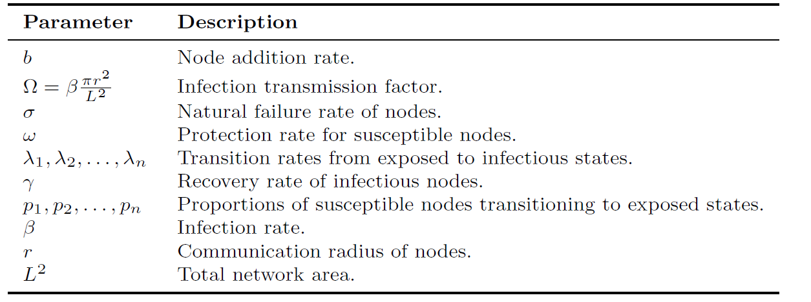
Introduction | Proposed System Architecture | Attack model | Machine learning model | Blockchain integration | Application Examples | Contributions | Conclusion
Epidemic-Based Mathematical Model (SMEIR)(7/13)
MILITARY TECHNICAL COLLEGE

Slide 41
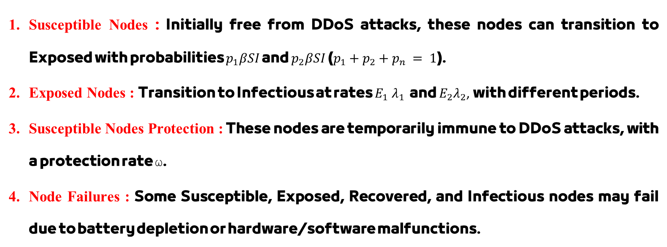
Introduction | Proposed System Architecture | Attack model | Machine learning model | Blockchain integration | Application Examples | Contributions | Conclusion
Epidemic-Based Mathematical Model (SMEIR)(8/13)
MILITARY TECHNICAL COLLEGE
Assumptions:
Susceptible Nodes : Initially free from DDoS attacks, these nodes can transition to Exposed with probabilities $p_{1}βSI$​ and $p_{2}βSI​$($p_{1}+p_{2}+p_{n} = 1$).
Exposed Nodes : Transition to Infectious at rates $E_{1} λ_{​1}$ and $E_{2}λ_{2}$​, with different periods.
Susceptible Nodes Protection : These nodes are temporarily immune to DDoS attacks, with a protection rate ω.
Node Failures : Some Susceptible, Exposed, Recovered, and Infectious nodes may fail due to battery depletion or hardware/software malfunctions.

Slide 42
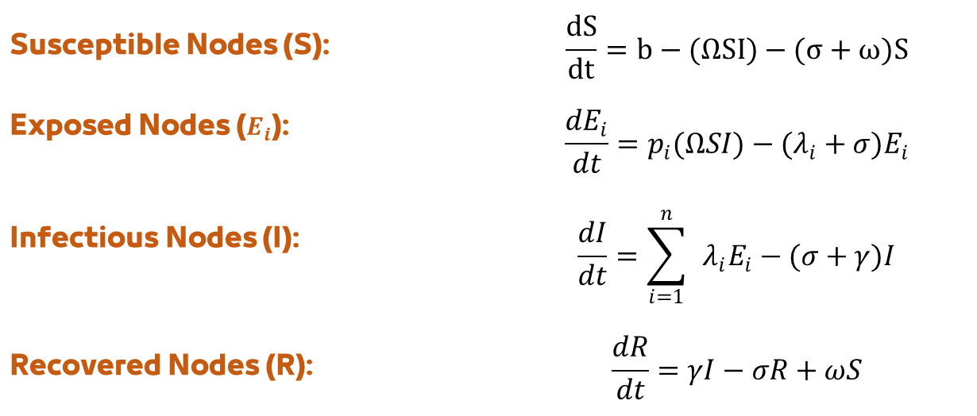
Introduction | Proposed System Architecture | Attack model | Machine learning model | Blockchain integration | Application Examples | Contributions | Conclusion
Epidemic-Based Mathematical Model (SMEIR)(9/13)
MILITARY TECHNICAL COLLEGE
Model Equations
1- The total number of nodes at time $t≥0$ is N(t), Where:
$$N(t)=S(t)+E_{1}(t)+E_{2}(t)+I(t)+R(t)$$
2- ODEs describing the rate of change in each class are as follows:
Susceptible Nodes (S): | $$\frac{dS}{dt}=b−(ΩSI)−(σ+ω)S$$
Exposed Nodes ($E_{i}$): | $$\frac{dE_{i}}{dt}=p_{i}(ΩSI)−(λ_{i}+σ)E_{i}$$
Infectious Nodes (I): | $$\frac{dI}{dt}=\sum_{i=1}^{n}{ }λ_{i}E_{i}−(σ+γ)I$$
Recovered Nodes (R): | $$\frac{dR}{dt}=γI−σR+ωS$$

Slide 43
Introduction | Proposed System Architecture | Attack model | Machine learning model | Blockchain integration | Application Examples | Contributions | Conclusion
Epidemic-Based Mathematical Model (SMEIR)(10/13)
MILITARY TECHNICAL COLLEGE
Stability and Equilibrium Analysis
DDoS-free equilibrium is the state where all exposed and infected nodes are zero (𝐸₁ = 𝐸₂ = … = 𝐸ₙ = 𝐼 = 0), simplifying the equations to only include susceptible (S) and recovered (R) nodes.
Endemic equilibrium (𝐸₁ = 𝐸₂ = … = 𝐸ₙ = 𝐼 ≠ 0),

Slide 44
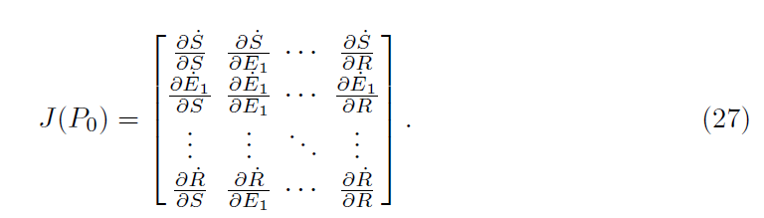
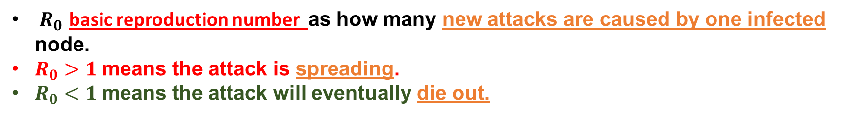

Introduction | Proposed System Architecture | Attack model | Machine learning model | Blockchain integration | Application Examples | Contributions | Conclusion
Epidemic-Based Mathematical Model (SMEIR)(11/13)
MILITARY TECHNICAL COLLEGE
Stability and Equilibrium Analysis
$R_{0}$​ basic reproduction number as how many new attacks are caused by one infected node.
$R_{0}>1$means the attack is spreading.
$R_{0}<1$means the attack will eventually die out.
$$R_{0}= \frac{\text{Infection} \text{Rate}\text{×}\text{Contact} \text{Rate}}{\text{Total} \text{Removal} \text{Rates} \text{from} \text{Susceptible} \text{and} \text{Infected} \text{Groups}}$$
By Jacobian matrix and eigenvalue condition
The system is locally stable at $P_{0}$ and $P^{∗ }$if all eigenvalues of the Jacobian matrix have negative real parts.

Slide 45
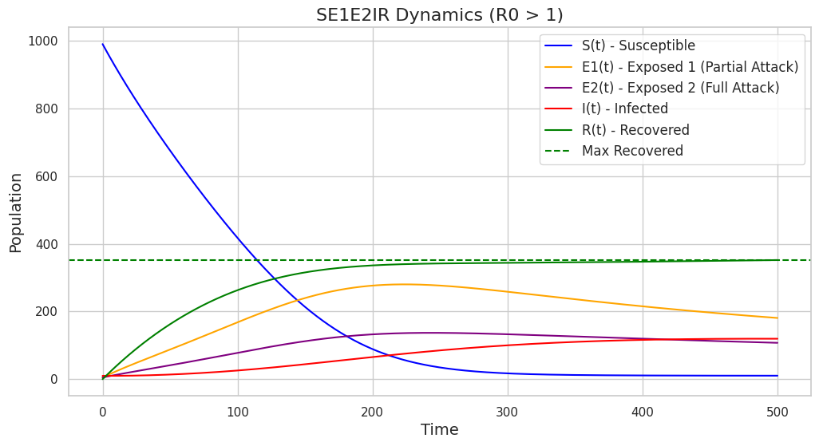
Introduction | Proposed System Architecture | Attack model | Machine learning model | Blockchain integration | Application Examples | Contributions | Conclusion
Epidemic-Based Mathematical Model (SMEIR)(12/13)
MILITARY TECHNICAL COLLEGE
Analytical Simulation Results and Analysis
Figure shows the network's endemic state when $R_{0}>1$ where DDoS attacks persist, outpacing recovery. It highlights the need for strong mitigation to stabilize the system.
Notes:
Problem 2.2.1
Problem 2.2.2
Problem 2.2.3

Slide 46
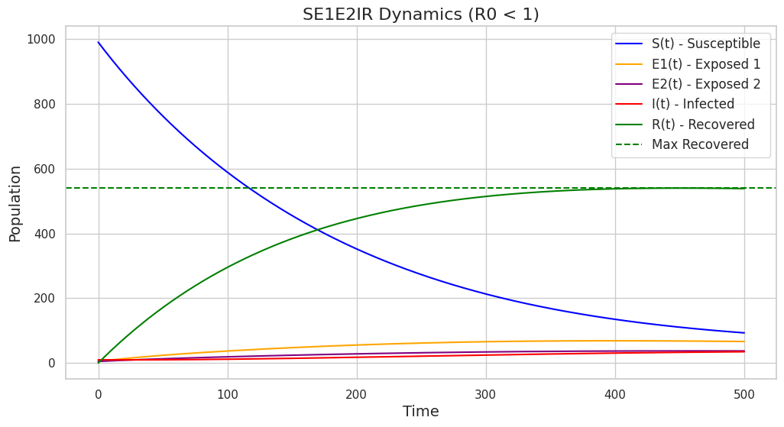

Introduction | Proposed System Architecture | Attack model | Machine learning model | Blockchain integration | Application Examples | Contributions | Conclusion
Epidemic-Based Mathematical Model (SMEIR)(13/13)
MILITARY TECHNICAL COLLEGE
Analytical Simulation Results and Analysis
The figure shows the network stabilizing when $R_{0}<1$, where the infection spread is reduced. As time passes, the number of infected nodes decreases, emphasizing the need for targeted countermeasures to achieve security and stability.
Notes:
Problem 2.2.1
Problem 2.2.2
Problem 2.2.3

Slide 47
Introduction | Proposed System Architecture | Attack model | Machine learning model | Blockchain integration | Application Examples | Contributions | Conclusion
Outline(cont.)
MILITARY TECHNICAL COLLEGE
Machine learning model
Dataset and Preprocessing
Feature Selection
ML Models and Performance

Slide 48
Introduction | Proposed System Architecture | Attack model | Machine learning model | Blockchain integration | Application Examples | Contributions | Conclusion
Dataset and Preprocessing
MILITARY TECHNICAL COLLEGE
Datasets used
Dataset | Focus Area | Records | Format
CICDDoS2019 | Network Layer | ~80 GB | PCAP, CSV
NSL-KDD | Network Layer | 148,517 | Preprocessed CSV
N-BaIoT | IoT Botnet Traffic | 800,000+ | CSV
TON_IoT | IoT & IIoT | 3,000,000+ | CSV, Network logs
CICIoT2023 | Large-scale IoT/IIoT | 7,000,000+ | CSV, Telemetry logs
DDoSBotnet | IoT Botnet Attacks | 500,000+ | CSV
Notes:
Problem 2.2.1
Problem 2.2.2
Problem 2.2.3

Slide 49
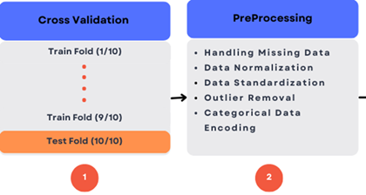
Introduction | Proposed System Architecture | Attack model | Machine learning model | Blockchain integration | Application Examples | Contributions | Conclusion
Dataset and Preprocessing
MILITARY TECHNICAL COLLEGE
Preprocessing:
Handling Missing data
Data Normalization
Data Standardizations
Outlier Removal
Categorical Data
Encoding
Notes:
Problem 2.2.1
Problem 2.2.2
Problem 2.2.3

Slide 50
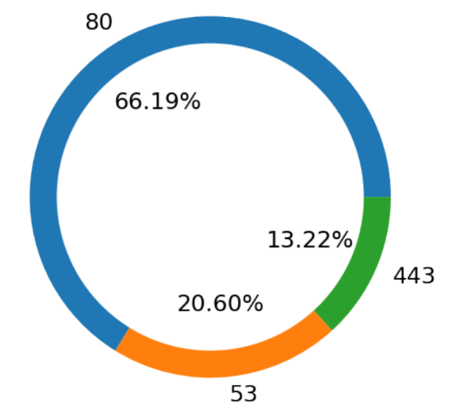
Introduction | Proposed System Architecture | Attack model | Machine learning model | Blockchain integration | Application Examples | Contributions | Conclusion
Dataset visualization
MILITARY TECHNICAL COLLEGE
Data analysis and visualization
Notes:
Problem 2.2.1
Problem 2.2.2
Problem 2.2.3

Slide 51
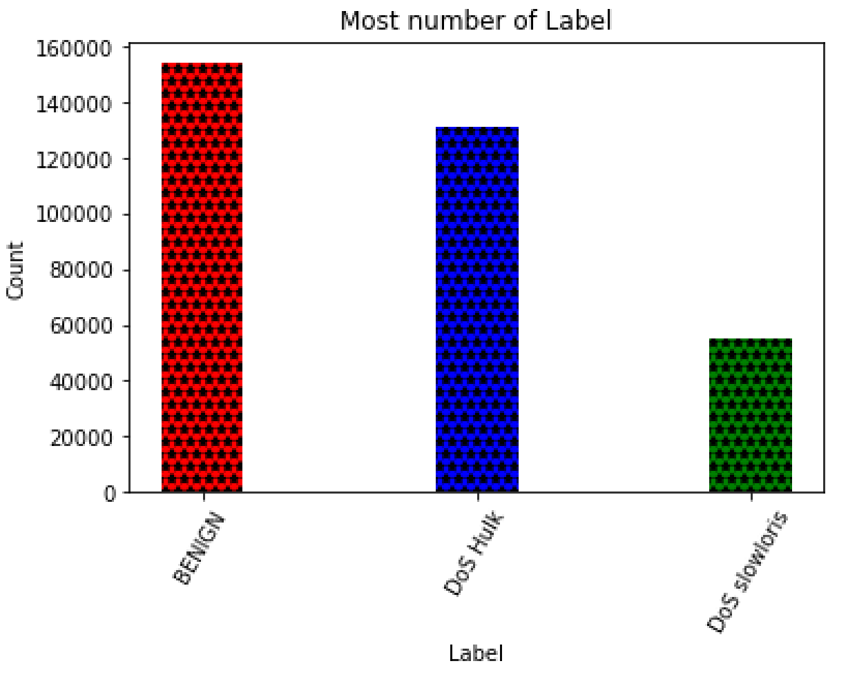
Introduction | Proposed System Architecture | Attack model | Machine learning model | Blockchain integration | Application Examples | Contributions | Conclusion
Dataset visualization
MILITARY TECHNICAL COLLEGE
Data analysis and visualization
Notes:
Problem 2.2.1
Problem 2.2.2
Problem 2.2.3

Slide 52
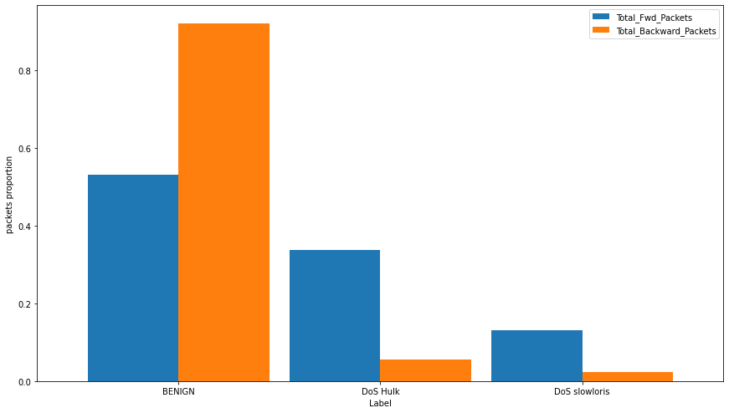
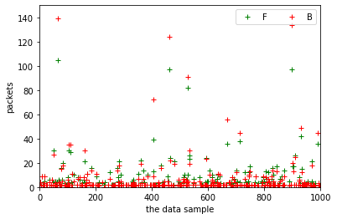
Introduction | Proposed System Architecture | Attack model | Machine learning model | Blockchain integration | Application Examples | Contributions | Conclusion
Dataset visualization
MILITARY TECHNICAL COLLEGE
Data analysis and visualization
Notes:
Problem 2.2.1
Problem 2.2.2
Problem 2.2.3

Slide 53
Introduction | Proposed System Architecture | Attack model | Machine learning model | Blockchain integration | Application Examples | Contributions | Conclusion
Outline(cont.)
MILITARY TECHNICAL COLLEGE
Machine learning model
Dataset and Preprocessing
Feature Selection
ML Models and Performance

Slide 54
Introduction | Proposed System Architecture | Attack model | Machine learning model | Blockchain integration | Application Examples | Contributions | Conclusion
Feature Selection(1/4)
MILITARY TECHNICAL COLLEGE
Method | Computational Load | Time Complexity | Suitability | Reference
Mutual Info (MI) | Moderate | O(n log n) | High | [27]
RFE | High | O(d²·T) | High | [28]
CBF | Low | O(n) | High | [29]
PCA | Moderate | O(p³) | Low | [30]
LASSO | Moderate | O(np) | Moderate | [31]
Chi-Squared | Low | O(n) | Low | [32]
Variance Threshold | Low | O(n) | Low | [33]
Notes:
Problem 2.2.1
Problem 2.2.2
Problem 2.2.3

Slide 55
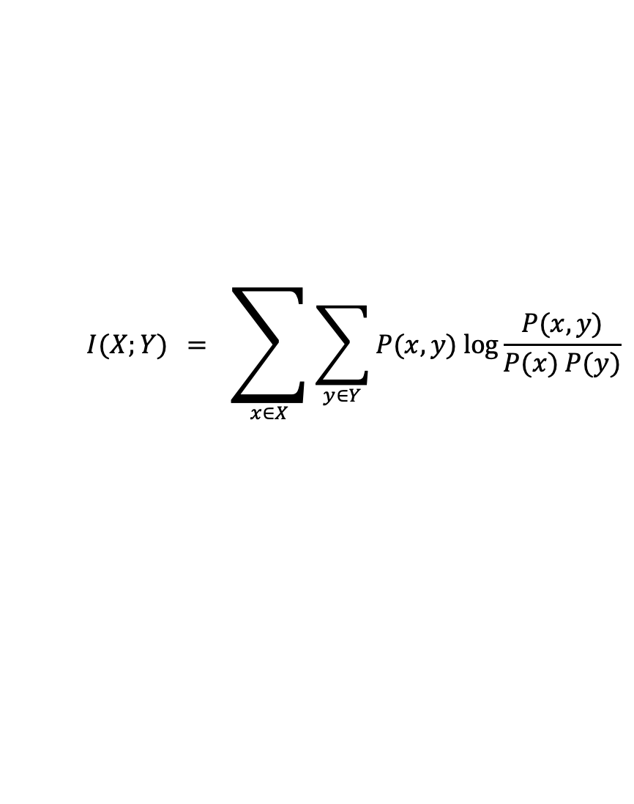
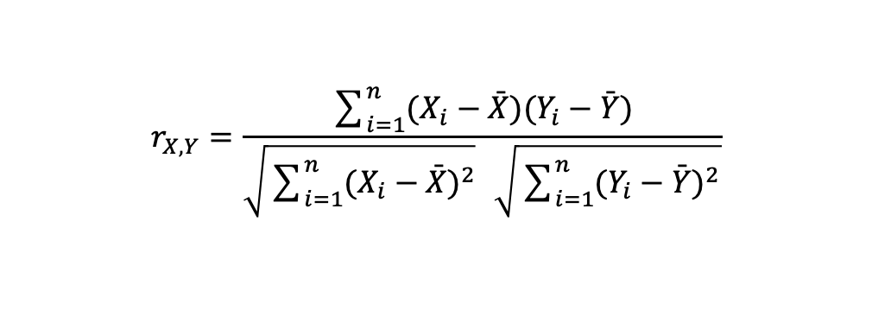
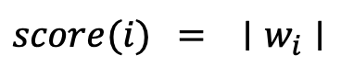
Introduction | Proposed System Architecture | Attack model | Machine learning model | Blockchain integration | Application Examples | Contributions | Conclusion
Feature Selection(2/4)
MILITARY TECHNICAL COLLEGE
Mutual Information (MI)
$$I(X;Y) = \sum_{x∈X}{\sum_{y∈Y}{P(x,y) log\frac{P(x,y)}{P(x) P(y)}}}$$
Recursive Feature Elimination (RFE)
$$score(i) = ∣w_{i}∣$$
(Here, $w_{i}$​ is the model’s weight for feature i.)
Correlation‐Based Filtering (CBF)
$$r_{X,Y}=\frac{\sum_{i=1}^{n}{(X_{i}−\overset{ˉ}{X})(Y_{i}−\overset{ˉ}{Y})}}{\sqrt{\sum_{i=1}^{n}{(X_{i}−\overset{ˉ}{X})^{2}}} \sqrt{\sum_{i=1}^{n}{(Y_{i}−\overset{ˉ}{Y})^{2}}}}$$
Notes:
Problem 2.2.1
Problem 2.2.2
Problem 2.2.3

Slide 56
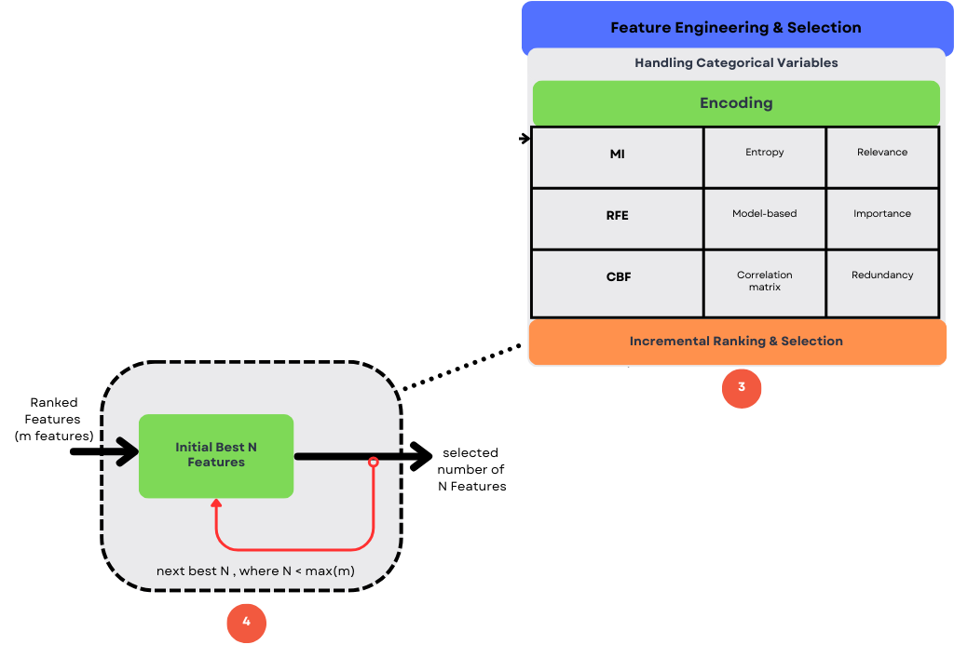
Introduction | Proposed System Architecture | Attack model | Machine learning model | Blockchain integration | Application Examples | Contributions | Conclusion
Feature Selection(3/4)
MILITARY TECHNICAL COLLEGE
Notes:
Problem 2.2.1
Problem 2.2.2
Problem 2.2.3

Slide 57
Introduction | Proposed System Architecture | Attack model | Machine learning model | Blockchain integration | Application Examples | Contributions | Conclusion
Outline(cont.)
MILITARY TECHNICAL COLLEGE
Machine learning model
Dataset and Preprocessing
Feature Selection
ML Models and Performance

Slide 58
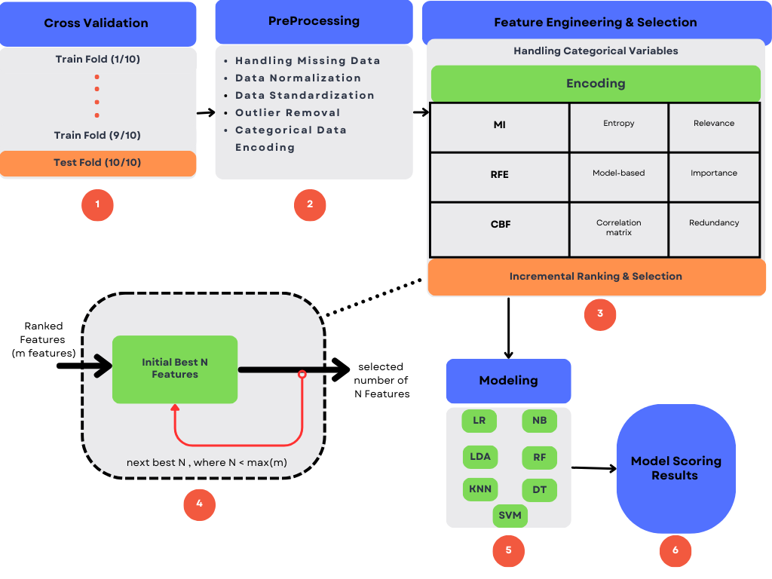
Introduction | Proposed System Architecture | Attack model | Machine learning model | Blockchain integration | Application Examples | Contributions | Conclusion
ML Models and Performance(1/18)
MILITARY TECHNICAL COLLEGE
Notes:
Problem 2.2.1
Problem 2.2.2
Problem 2.2.3

Slide 59
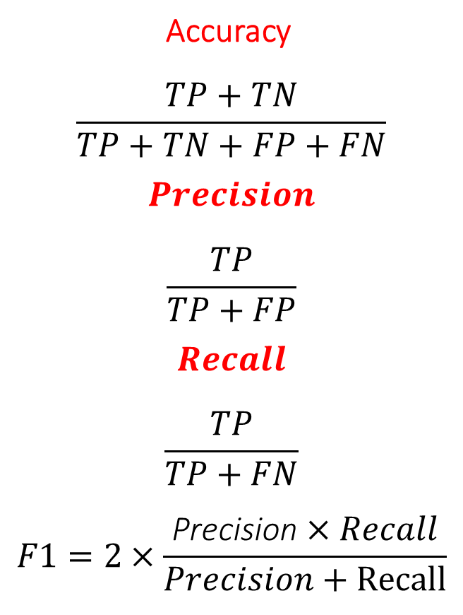
Introduction | Proposed System Architecture | Attack model | Machine learning model | Blockchain integration | Application Examples | Contributions | Conclusion
ML Models and Performance(2/18)
MILITARY TECHNICAL COLLEGE
Key Metrics:
Confusion Matrix :
TP (True Positive): Attack correctly detected
TN (True Negative): Normal traffic correctly identified
FP (False Positive): Normal traffic wrongly flagged as an attack
FN (False Negative): Attack missed and treated as normal
$$\text{Accuracy}$$
$$\frac{TP+TN}{TP+TN+FP+FN}$$
$$Precision$$
$$\frac{TP}{TP+FP}$$
$$Recall$$
$$\frac{TP}{TP+FN}$$
$$F1=2×\frac{\text{Precision}×Recall}{Precision+Recall}$$
Notes:
Problem 2.2.1
Problem 2.2.2
Problem 2.2.3

Slide 60
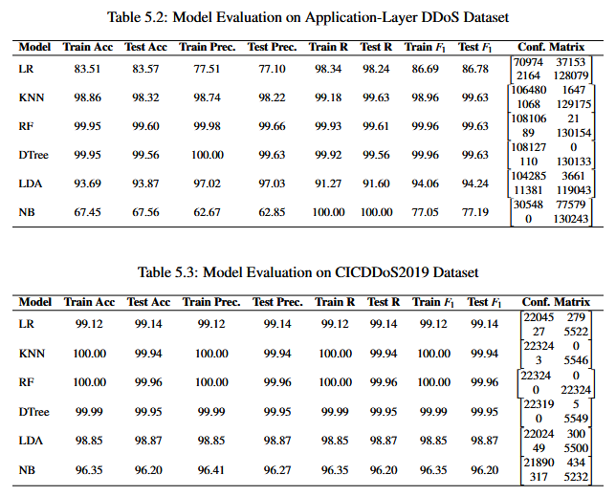
Introduction | Proposed System Architecture | Attack model | Machine learning model | Blockchain integration | Application Examples | Contributions | Conclusion
ML Models and Performance(3/18)
MILITARY TECHNICAL COLLEGE
Notes:
Problem 2.2.1
Problem 2.2.2
Problem 2.2.3

Slide 61
Introduction | Proposed System Architecture | Attack model | Machine learning model | Blockchain integration | Application Examples | Contributions | Conclusion
ML Models and Performance(4/18)
MILITARY TECHNICAL COLLEGE
Notes:
Problem 2.2.1
Problem 2.2.2
Problem 2.2.3

Slide 62
Introduction | Proposed System Architecture | Attack model | Machine learning model | Blockchain integration | Application Examples | Contributions | Conclusion
ML Models and Performance(5/18)
MILITARY TECHNICAL COLLEGE
Notes:
Problem 2.2.1
Problem 2.2.2
Problem 2.2.3

Slide 63
Introduction | Proposed System Architecture | Attack model | Machine learning model | Blockchain integration | Application Examples | Contributions | Conclusion
ML Models and Performance(6/18)
MILITARY TECHNICAL COLLEGE
Notes:
Problem 2.2.1
Problem 2.2.2
Problem 2.2.3

Slide 64
Introduction | Proposed System Architecture | Attack model | Machine learning model | Blockchain integration | Application Examples | Contributions | Conclusion
ML Models and Performance(7/18)
MILITARY TECHNICAL COLLEGE
Notes:
Problem 2.2.1
Problem 2.2.2
Problem 2.2.3

Slide 65
Introduction | Proposed System Architecture | Attack model | Machine learning model | Blockchain integration | Application Examples | Contributions | Conclusion
ML Models and Performance(8/18)
MILITARY TECHNICAL COLLEGE
Notes:
Problem 2.2.1
Problem 2.2.2
Problem 2.2.3

Slide 66
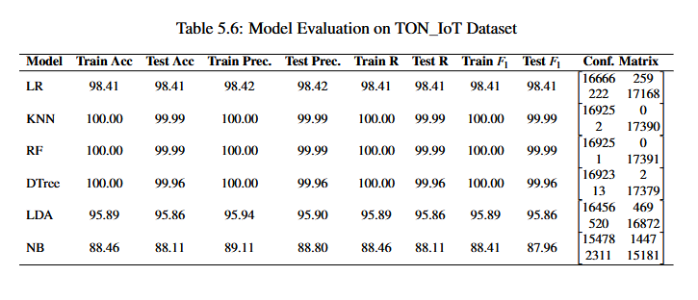
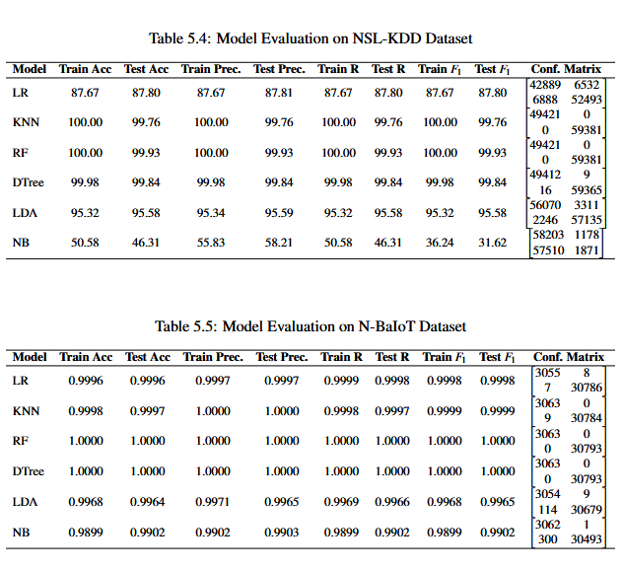
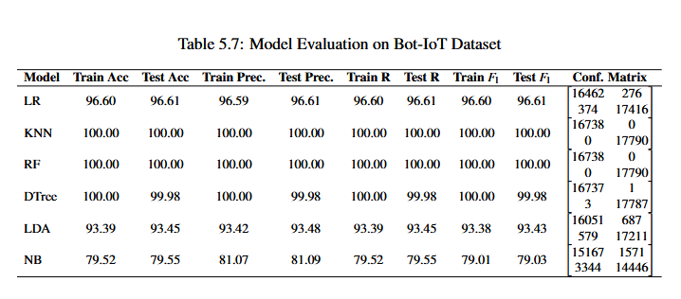
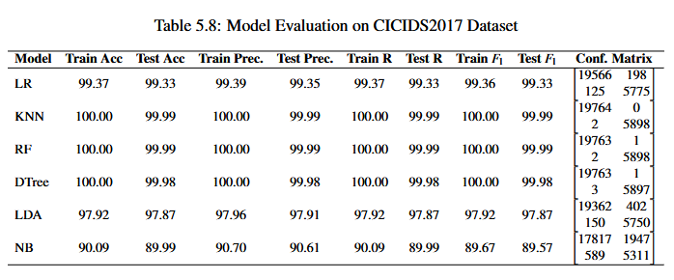
Introduction | Proposed System Architecture | Attack model | Machine learning model | Blockchain integration | Application Examples | Contributions | Conclusion
ML Models and Performance(9/18)
MILITARY TECHNICAL COLLEGE
Notes:
Problem 2.2.1
Problem 2.2.2
Problem 2.2.3

Slide 67
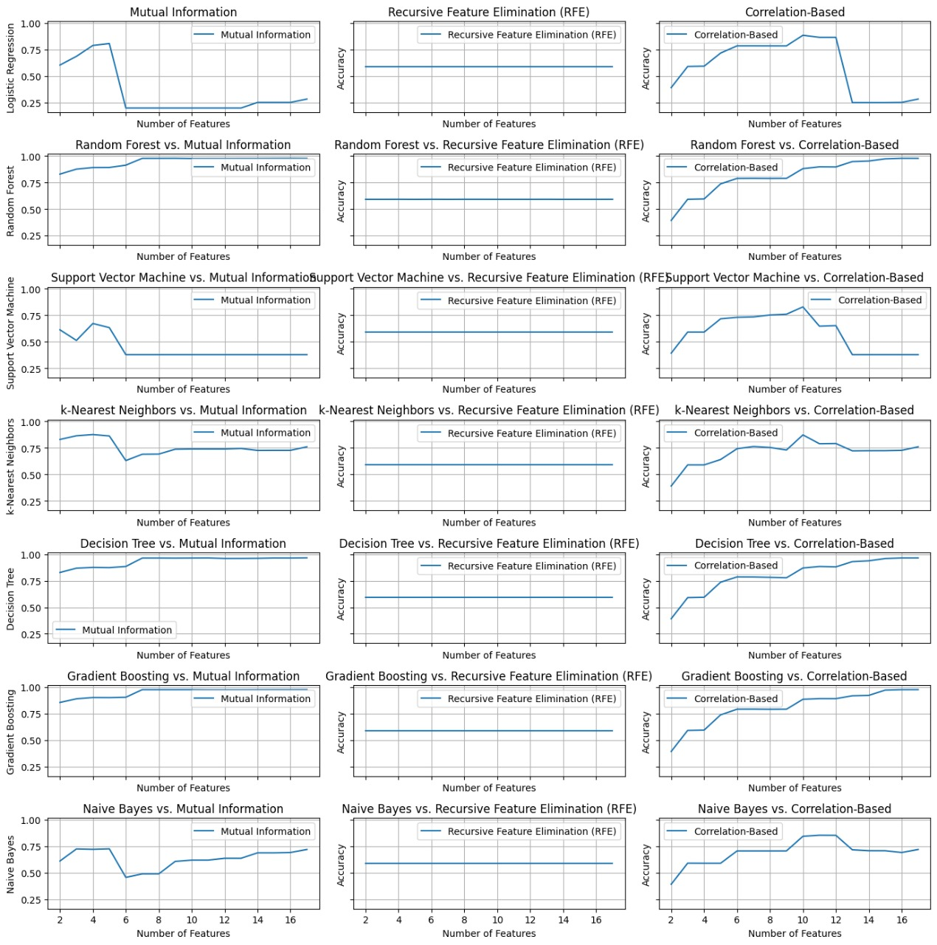
Introduction | Proposed System Architecture | Attack model | Machine learning model | Blockchain integration | Application Examples | Contributions | Conclusion
ML Models and Performance(10/18)
MILITARY TECHNICAL COLLEGE
Feature selection analysis

Slide 68
Introduction | Proposed System Architecture | Attack model | Machine learning model | Blockchain integration | Application Examples | Contributions | Conclusion
ML Models and Performance(11/18)
MILITARY TECHNICAL COLLEGE
Feature selection analysis

Slide 69
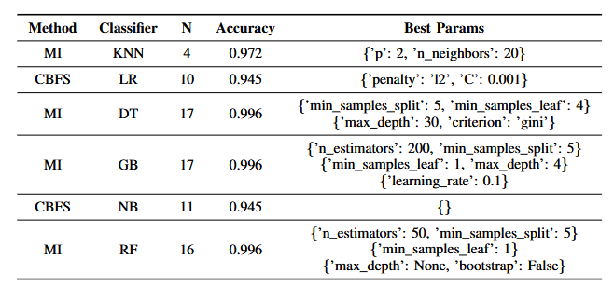
Introduction | Proposed System Architecture | Attack model | Machine learning model | Blockchain integration | Application Examples | Contributions | Conclusion
ML Models and Performance(12/18)
MILITARY TECHNICAL COLLEGE
Feature selection analysis

Slide 70
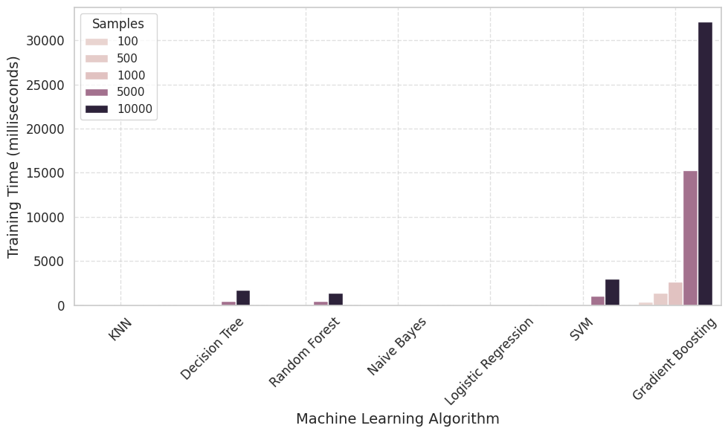
Introduction | Proposed System Architecture | Attack model | Machine learning model | Blockchain integration | Application Examples | Contributions | Conclusion
ML Models and Performance(13/18)
MILITARY TECHNICAL COLLEGE
Efficiency Analysis of ML Models
1- Efficiency Based on Execution Time

Slide 71
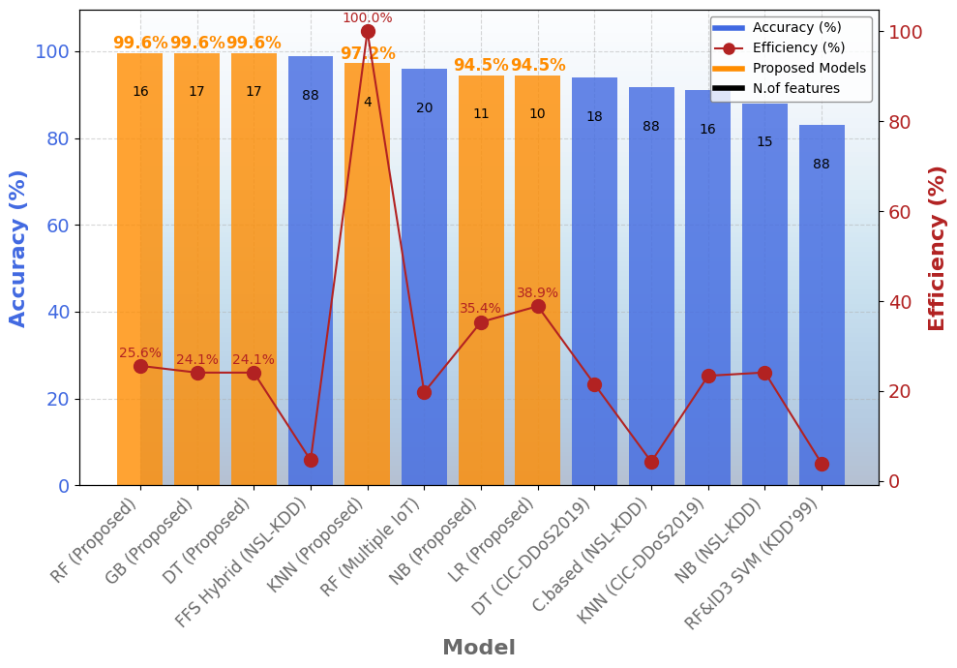
Introduction | Proposed System Architecture | Attack model | Machine learning model | Blockchain integration | Application Examples | Contributions | Conclusion
ML Models and Performance(14/18)
MILITARY TECHNICAL COLLEGE
Efficiency Analysis of ML Models
2- Efficiency Based on Feature Selection

Slide 72
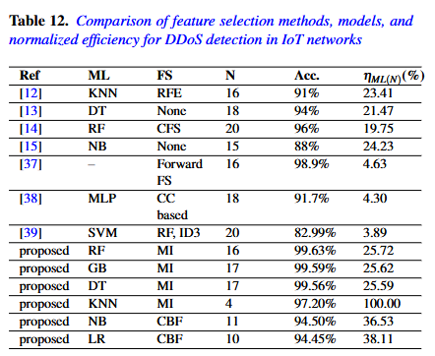
Introduction | Proposed System Architecture | Attack model | Machine learning model | Blockchain integration | Application Examples | Contributions | Conclusion
ML Models and Performance(15/18)
MILITARY TECHNICAL COLLEGE
Comparison Analysis of ML Models based on feature selection and normalized efficiency

Slide 73
Introduction | Proposed System Architecture | Attack model | Machine learning model | Blockchain integration | Application Examples | Contributions | Conclusion
ML Models and Performance(16/18)
MILITARY TECHNICAL COLLEGE
Comparison Analysis of ML Models based on feature selection and normalized efficiency

Slide 74
Introduction | Proposed System Architecture | Attack model | Machine learning model | Blockchain integration | Application Examples | Contributions | Conclusion
ML Models and Performance(17/18)
MILITARY TECHNICAL COLLEGE

Slide 75
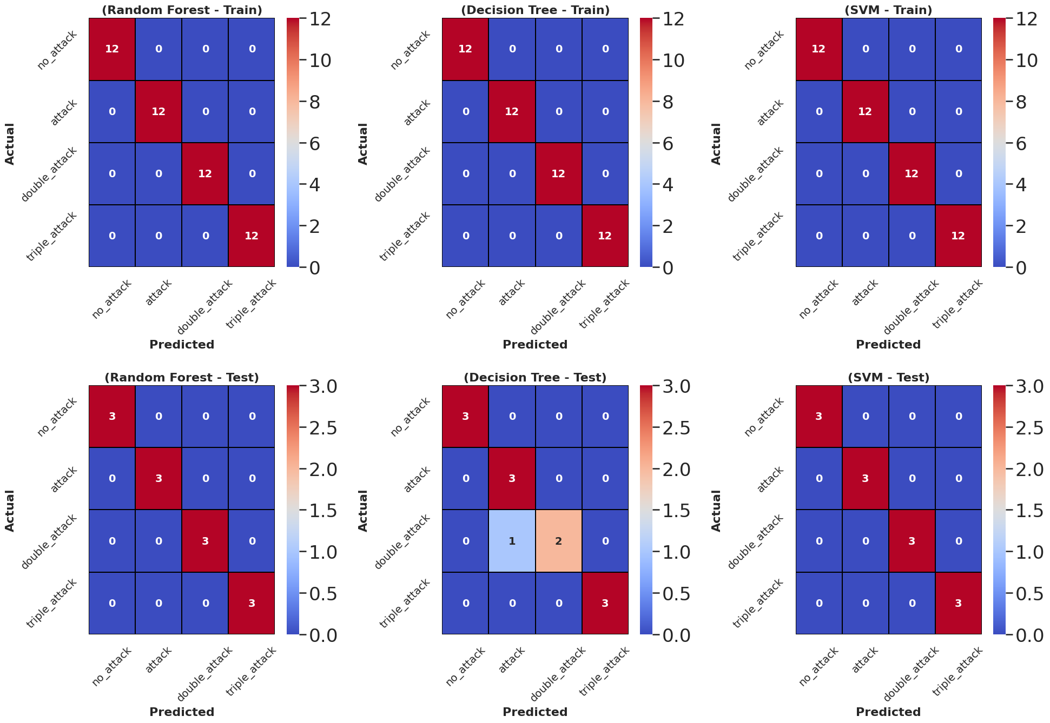
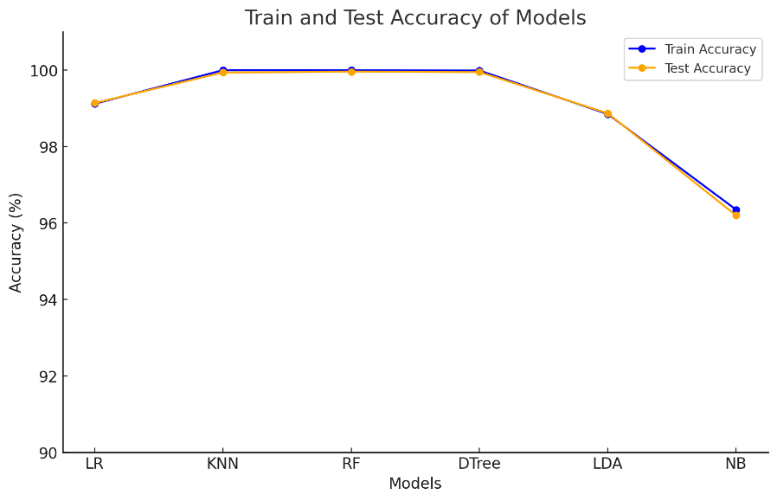
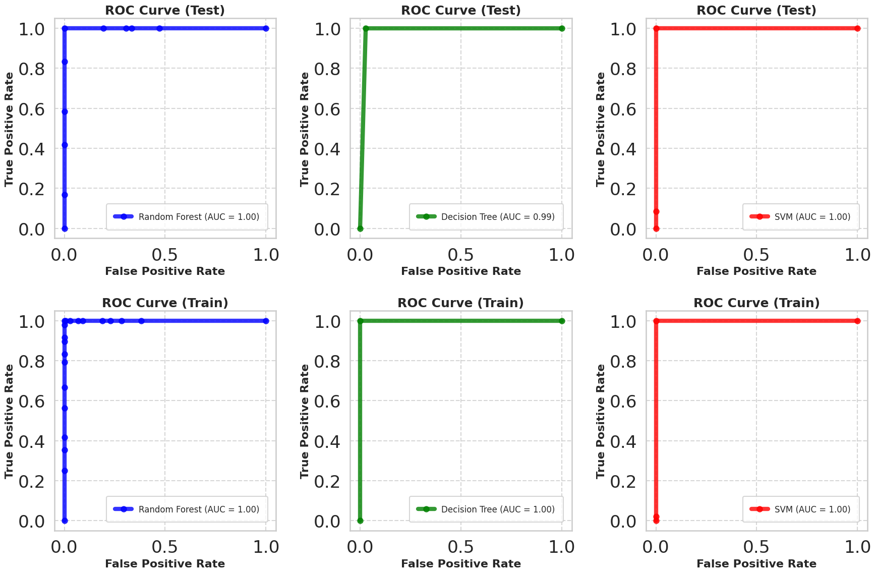
Introduction | Proposed System Architecture | Attack model | Machine learning model | Blockchain integration | Application Examples | Contributions | Conclusion
ML Models and Performance(18/18)
MILITARY TECHNICAL COLLEGE
DDoS attack model dataset analysis
Fig. Comparison accuracy of various ML models
Table : Machine Learning Model on CICD-DoS2019
Model | Train Acc. | Test Acc. | Train Prec. | Test Prec. | Train Recall | Test Recall
LR | 99.12 | 99.14 | 99.12 | 99.14 | 99.12 | 99.14
KNN | 100 | 99.94 | 100 | 99.94 | 100 | 99.94
RF | 100 | 99.96 | 100 | 99.96 | 100 | 99.96
DTree | 99.99 | 99.95 | 99.99 | 99.95 | 99.99 | 99.95
LDA | 98.85 | 98.87 | 98.85 | 98.87 | 98.85 | 98.87
NB | 96.35 | 96.2 | 96.41 | 96.27 | 96.35 | 96.2

Slide 76
Introduction | Proposed System Architecture | Attack model | Machine learning model | Blockchain integration | Application Examples | Contributions | Conclusion
Outline(cont.)
MILITARY TECHNICAL COLLEGE
Blockchain Integration

Slide 77
Introduction | Proposed System Architecture | Attack model | Machine learning model | Blockchain integration | Application Examples | Contributions | Conclusion
Blockchain Integration(1/8)
MILITARY TECHNICAL COLLEGE
Why Blockchain? Ensures trust, integrity, and tamper-resistance; removes centralized authorities and single points of failure.
System Role Logs verified DDoS alerts immutably, supports distributed event validation, and enables secure, transparent node communication.
Design Overview Uses a permissioned blockchain at the base station level; only trusted base stations mine; IoT devices serve as light nodes (data providers only).
Base Station (Blockchain Controller) Each BS controls its gateways and sensors, acts as a trusted blockchain peer, and maintains trust scores for all connected sensors.
Trust Management BS computes average trust scores. These scores affect transaction validation
malicious nodes get lower trust scores and reduced influence.
Notes:
Problem 2.2.1
Problem 2.2.2
Problem 2.2.3

Slide 78
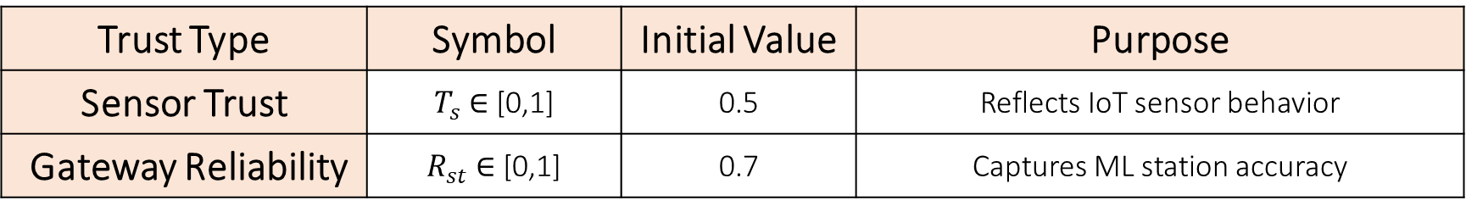
Introduction | Proposed System Architecture | Attack model | Machine learning model | Blockchain integration | Application Examples | Contributions | Conclusion
Blockchain Integration(2/8)
MILITARY TECHNICAL COLLEGE
Trust Model Architecture
Trust Components
Trust Type | Symbol | Initial Value | Purpose
Sensor Trust | $T_{s}$ ∈ [0,1] | 0.5 | Reflects IoT sensor behavior
Gateway Reliability | $R_{st}$ ∈ [0,1] | 0.7 | Captures ML station accuracy
Notes:
Problem 2.2.1
Problem 2.2.2
Problem 2.2.3

Slide 79
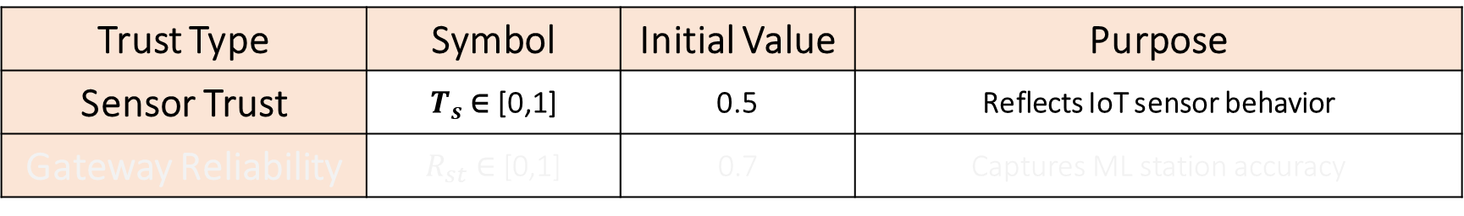

Introduction | Proposed System Architecture | Attack model | Machine learning model | Blockchain integration | Application Examples | Contributions | Conclusion
Blockchain Integration(3/8)
MILITARY TECHNICAL COLLEGE
Trust Model Architecture
Trust Type | Symbol | Initial Value | Purpose
Sensor Trust | $T_{s}$ ∈ [0,1] | 0.5 | Reflects IoT sensor behavior
Gateway Reliability | $R_{st}$ ∈ [0,1] | 0.7 | Captures ML station accuracy
Trust Update Rules
1- Sensor Trust Adjustment:
$$T_{s}^{new}=\left\{\begin{matrix}max(0,T_{s}−αc), & c>τ_{h}(\text{high}\text{−}\text{confidence} \text{anomaly}) \\ min(1,T_{s}+β), & c<τ_{l} (\text{low}\text{−}\text{confidence} \text{anomaly}) \\ T_{s}, & \text{otherwise}\end{matrix}\right.$$
High/Low Thresholds: $τ_{h}$ = 0.7, $τ_{l}$ = 0.3
Penalty: α = 0.1, Recovery: β = 0.01
Notes:
Problem 2.2.1
Problem 2.2.2
Problem 2.2.3

Slide 80


Introduction | Proposed System Architecture | Attack model | Machine learning model | Blockchain integration | Application Examples | Contributions | Conclusion
Blockchain Integration(4/8)
MILITARY TECHNICAL COLLEGE
Trust Model Architecture
Trust Type | Symbol | Initial Value | Purpose
Sensor Trust | $T_{s}$ ∈ [0,1] | 0.5 | Reflects IoT sensor behavior
Gateway Reliability | $R_{st}$ ∈ [0,1] | 0.7 | Captures ML station accuracy
Trust Update Rules
2- Gateway Reliability Score Adjustment
$$R_{st}^{new}=\left\{\begin{matrix}min(1,R_{st}+γ), & \text{if} \text{correct} \\ max(0,R_{st}−δ), & \text{if} \text{incorrect}\end{matrix}\right.$$
γ = 0.01: Increment applied when a station makes a correct prediction.
δ = 0.05: Penalty applied when a station makes an incorrect prediction.
Notes:
Problem 2.2.1
Problem 2.2.2
Problem 2.2.3

Slide 81

Introduction | Proposed System Architecture | Attack model | Machine learning model | Blockchain integration | Application Examples | Contributions | Conclusion
Blockchain Integration(5/8)
MILITARY TECHNICAL COLLEGE
Trust Model Architecture
Trust Decay Mechanism
To avoid stale or overfitted trust values, the framework applies an exponential function to gradually move scores back toward a neutral state${(T}_{default})$
$$T_{s}^{t+1}=λT_{s}^{t}+(1−λ)T_{default}$$
λ = 0.9 : Decay coefficient; controls the influence of historical trust vs. reversion.
${(T}_{default})$= 0.5: The neutral baseline trust score toward which scores decay over time.
Notes:
Problem 2.2.1
Problem 2.2.2
Problem 2.2.3

Slide 82

Introduction | Proposed System Architecture | Attack model | Machine learning model | Blockchain integration | Application Examples | Contributions | Conclusion
Blockchain Integration(6/8)
MILITARY TECHNICAL COLLEGE
“In our system, each base station maintains a lightweight, permissioned blockchain to securely log network events and manage node trust dynamically.”
Notes:
Problem 2.2.1
Problem 2.2.2
Problem 2.2.3

Slide 83

Introduction | Proposed System Architecture | Attack model | Machine learning model | Blockchain integration | Application Examples | Contributions | Conclusion
Blockchain Integration(7/8)
MILITARY TECHNICAL COLLEGE
“In our system, each base station maintains a lightweight, permissioned blockchain to securely log network events and manage node trust dynamically.”
Notes:
Problem 2.2.1
Problem 2.2.2
Problem 2.2.3

Slide 84

Introduction | Proposed System Architecture | Attack model | Machine learning model | Blockchain integration | Application Examples | Contributions | Conclusion
Blockchain Integration(8/8)
MILITARY TECHNICAL COLLEGE
Notes:
Problem 2.2.1
Problem 2.2.2
Problem 2.2.3

Slide 85
Introduction | Proposed System Architecture | Attack model | Machine learning model | Blockchain integration | Application Examples | Contributions | Conclusion
Outline(cont.)
MILITARY TECHNICAL COLLEGE
Application Examples

Slide 86

Introduction | Proposed System Architecture | Attack model | Machine learning model | Blockchain integration | Application Examples | Contributions | Conclusion
Application Examples(1/4)
MILITARY TECHNICAL COLLEGE
Application and Direct Impact
blockchain for secure decentralized IoT networks integrating with ML | Result
yes | Application
$$⋆⋆⋆⋆⋆$$ | Public Health
$$⋆⋆⋆⋆⋆$$ | Military and Public Safety
$$⋆⋆⋆⋆⋆$$ | Education/Culture
$$⋆⋆⋆⋆⋆$$ | Environment/Climate
$$⋆⋆⋆⋆⋆$$ | Infrastructure/Economic

Slide 87



Introduction | Proposed System Architecture | Attack model | Machine learning model | Blockchain integration | Application Examples | Contributions | Conclusion
Application Examples(2/4)
MILITARY TECHNICAL COLLEGE
🎉🎉application example apply this on EH system with Blockchain architecture

Slide 88

Introduction | Proposed System Architecture | Attack model | Machine learning model | Blockchain integration | Application Examples | Contributions | Conclusion
Application Examples(3/4)
MILITARY TECHNICAL COLLEGE
🎉application example apply this on EH system with Blockchain architecture

Slide 89



Introduction | Proposed System Architecture | Attack model | Machine learning model | Blockchain integration | Application Examples | Contributions | Conclusion
Application Examples(4/4)
MILITARY TECHNICAL COLLEGE
🎉apply this credit card fraud detection system with Blockchain architecture & ML
Notes:
Problem 2.2.1
Problem 2.2.2
Problem 2.2.3

Slide 90
Introduction | Proposed System Architecture | Attack model | Machine learning model | Blockchain integration | Application Examples | Contributions | Conclusion
Outline(cont.)
MILITARY TECHNICAL COLLEGE
Contributions

Slide 91
Introduction | Proposed System Architecture | Attack model | Machine learning model | Blockchain integration | Application Examples | Contributions | Conclusion
Contributions
MILITARY TECHNICAL COLLEGE
Contribution | Publication
Designed a Blockchain-based decentralized trust system for IoT emergency management | Blockchain for Decentralized Emergency Management System
Integrated lightweight Machine Learning with Blockchain to mitigate DDoS attacks in IoT | DDoS Mitigation in IoT Using Machine Learning and Blockchain Integration
Developed feature-optimized lightweight ML models for efficient DDoS detection | Lightweight Machine Learning Models for DDoS Mitigation in IoT Networks
Proposed and analyzed a modified SMEIR epidemic model for DDoS propagation and mitigation | Stability Analysis and Mitigation of DDoS Attacks in Wireless Sensor Networks

Slide 92
Introduction | Proposed System Architecture | Attack model | Machine learning model | Blockchain integration | Application Examples | Contributions | Conclusion
Outline(cont.)
MILITARY TECHNICAL COLLEGE
Conclusion
Future Work
References

Slide 93
Introduction | Proposed System Architecture | Attack model | Machine learning model | Blockchain integration | Application Examples | Contributions | Conclusion
Conclusion
MILITARY TECHNICAL COLLEGE
Designed a lightweight and secure system for IoT using Machine Learning and Blockchain.
Developed a mathematical model to study and control DDoS attacks.
Verified the system’s effectiveness through simulation and analytical validation.

Slide 94
Introduction | Proposed System Architecture | Attack model | Machine learning model | Blockchain integration | Application Examples | Contributions | Conclusion
Outline(cont.)
MILITARY TECHNICAL COLLEGE
Conclusion
Future Work
References
Acknowledgments & Questions

Slide 95
Introduction | Proposed System Architecture | Attack model | Machine learning model | Blockchain integration | Application Examples | Contributions | Conclusion
Future work
MILITARY TECHNICAL COLLEGE
Integrate with 6G, quantum tech, and AI
Expand applications to smart cities and critical IoT

Slide 96
Introduction | Proposed System Architecture | Attack model | Machine learning model | Blockchain integration | Application Examples | Contributions | Conclusion
Outline(cont.)
MILITARY TECHNICAL COLLEGE
Conclusion
Future Work
References

Slide 97
Introduction | Proposed System Architecture | Attack model | Machine learning model | Blockchain integration | Application Examples | Contributions | Conclusion
References(1/4)
MILITARY TECHNICAL COLLEGE
N. Ahsan et al., "Collaborative Threat Intelligence: Enhancing IoT Security through Blockchain and Machine Learning Integration," J. King Saud Univ. Comput. Inf. Sci., vol. 36, no. 2, 2024.
G. Shirvani et al., "Enhancing IoT Security Against DDoS Attacks through Federated Learning," arXiv preprint arXiv:2403.10968, 2024.
[A. Hekmati and B. Krishnamachari, "Correlation-Aware Neural Networks for DDoS Detection in IoT," arXiv preprint arXiv:2302.07982, 2023.
R. Jmal et al., "Distributed Blockchain-SDN Secure IoT System Based on ANN," Appl. Sci., vol. 13, no. 8, 2023.
M. Alzoubi, "Blockchain in IoT: Security, Applications, Technologies, and Challenges," Int. J. Blockchains Cryptocurr., vol. 4, no. 2, 2024.
W. Li, C. Stidsen, and T. Adam, "Blockchain-Assisted Intrusion Detection for Smart Cities," Comput. Electr. Eng., vol. 111, 2023.
L. Cui et al., "Security and Privacy-Enhanced Federated Learning for IoT Anomaly Detection," IEEE Trans. Ind. Informat., vol. 18, no. 5, 2022.
K. Bai et al., "Blockchain-Enabled Collaborative Anomaly Detection for IoT," MATEC Web Conf., vol. 392, 2024.

Slide 98
Introduction | Proposed System Architecture | Attack model | Machine learning model | Blockchain integration | Application Examples | Contributions | Conclusion
References(2/4)
MILITARY TECHNICAL COLLEGE
[M. Sarhan et al., "HBFL: Hierarchical Blockchain-Based Federated Learning for IoT," Comput. Electr. Eng., vol. 103, 2022.
I. H. Sarker, "ML for Intelligent Data Analysis in Cybersecurity," Ann. Data Sci., vol. 9, no. 1, 2022.
J. Peng et al., "Epidemic-Based Modeling of DDoS Attacks in Wireless Networks," IEEE Access, vol. 9, 2021.
R. Doshi et al., "DDoS Detection for Consumer IoT Devices," arXiv preprint arXiv:1804.04159, 2021.
A. Dorri et al., "Blockchain for IoT Security: Challenges and Solutions," IEEE Commun. Surv. Tutor., vol. 22, no. 2, 2021.
S. Mohanty et al., "Blockchain for Scalable IoT Applications," ACM Trans. Internet Technol., vol. 21, no. 1, 2022.
A. Banafa, "Blockchain Technology and IoT Security," IEEE Internet Things J., vol. 9, no. 3, 2021.
R. Roman et al., "Security and Privacy in IoT: Open Issues," Comput. Commun., vol. 166, 2021.
F. Ullah et al., "Cybersecurity Challenges in IoT: A Survey," J. Netw. Comput. Appl., vol. 191, 2021.
T. Salman et al., "Security and Privacy in IoT: A Blockchain Approach," IEEE Internet Things J., vol. 8, no. 1, 2021.
Y. Zhang et al., "Blockchain Technology for IoT Security," Sensors, vol. 22, no. 3, 2022.
S. Chaudhary et al., "Blockchain for IoT Data Management," IEEE Internet Things Mag., vol. 4, no. 3, 2021.
A. Conti et al., "IoT Security and Forensics: Challenges and Opportunities," Future Gener. Comput. Syst., vol. 123, 2021.

Slide 99
Introduction | Proposed System Architecture | Attack model | Machine learning model | Blockchain integration | Application Examples | Contributions | Conclusion
References(3/4)
MILITARY TECHNICAL COLLEGE
X. Chen, C. N. Chuah, Y. Hu, B. Li, T. Wang, D. Wu, J. Zhang, and N. Ge, “Real-time DDoS Defense in 5G-Enabled IoT: A Multidomain Collaboration Perspective,” IEEE Internet of Things Journal, vol. 10, no. 5, pp. 4490–4505, Mar. 2023.
I. Cvitić, D. Peraković, B. B. Gupta, and K.‑K. R. Choo, “Boosting-Based DDoS Detection in Internet of Things Systems,” IEEE Internet of Things Journal, vol. 9, no. 3, pp. 2109–2123, Jun. 2021.
R. Bekkouche, S. Shewane, M. Mahmud, H. Q. Nguyen, and S. Guo, “Ultra-Lightweight and Secure Intrusion Detection System for Massive-IoT Networks,” in Proc. IEEE Int. Conf. Commun. (ICC), 2022, pp. 1196–1201.
M. Dhaou, K. Wang, B. N. Mandayam, and H. Mouftah, “DDoS Attack Detection for IoT Using a Hybrid Deep Learning Model,” IEEE Access, vol. 11, pp. 119862–119875, 2023.
Y. Abdaade, A. Temouden, H. Bamoumen, N. Benamar, Y. Chtouki, and A. S. Hafid, “A Comprehensive Survey on TinyML,” IEEE Access, vol. 11, pp. 8–25, 2023.
Y. Liu, J. Wang, Z. Yan, Z. Wan, and R. Jantti, “A Survey on Blockchain-Based Trust Management for Internet of Things,” IEEE Internet of Things Journal, vol. 10, no. 7, pp. 5898–5922, Apr. 2023.
M. Wang, T. Zhu, X. Zuo, D. Ye, S. Yu, and W. Zhou, “Blockchain-Empowered Multiagent Systems: Advancing IoT Security and Transaction Efficiency,” IEEE Internet of Things Journal, vol. 11, no. 7, pp. 11217–11231, Apr. 2024.
A. A. Khan, A. A. Laghari, Z. A. Shaikh, Z. Dacko-Pikiewicz, and S. Kot, “Internet of Things (IoT) Security With Blockchain Technology: A State-of-the-Art Review,” IEEE Access, vol. 10, pp. 122679–122695, Nov. 2022.
S. S. Alsaleh, O. Ajeel, M. Munir, W. Saad, and H. Qaraqe, “Federated Learning-Based Model to Lightweight IDSs for Heterogeneous IoT Networks: State-of-the-Art, Challenges, and Future Directions,” IEEE Access, vol. 12, Art. no. 134269, 2024.
A. A. Abdallah, L. H. Al-Shboul, F. H. T. Vieira, and A. H. A. Bajwa, “Intrusion Detection Framework for the Internet of Things Using a Dense Random Neural Network,” IEEE Trans. Industrial Informatics, vol. 18, no. 9, pp. 6435–6444, Sep. 2022.
S.-J. Hsiao and W.-T. Sung, “Enhancing Cybersecurity Using Blockchain Technology Based on IoT Data Fusion,” IEEE Internet of Things Journal, vol. 10, no. 1, pp. 486–498, Jan. 2023.
X. Chen, Y. Qiao, Y. Hu, B. Li, and J. Zhang, “Decentralized Blockchain-Based and Trust-Aware Task Offloading for IoT Services,” IEEE Internet of Things Journal, vol. 11, no. 1, pp. 123–135, Jan. 2024.
T. Zhang, H. Feng, X. Cheng, and Z. Yan, “Lightweight Trust Management Scheme Based on Blockchain in Resource-Constrained Intelligent IoT Systems,” IEEE Internet of Things Journal, 2023 (to appear).
A. Asif, F. Zhang, M. Isaranuwatchai, M. St-Hilaire, R. B. Hoyt, and M. S. Obaidat, “Anomaly Detection in IoT Networks: From Architectures to Machine Learning Models,” IEEE Access, vol. 9, pp. 60607–60616, 2021.
V. Kim, J. Kang, W. Son, Y. Kim, and Y. Choi, “Design and Development of a Deep Learning-Based Model for Anomaly Detection in IoT Networks,” IEEE Access, vol. 9, pp. 99166–99175, 2021.

Slide 100
Introduction | Proposed System Architecture | Attack model | Machine learning model | Blockchain integration | Application Examples | Contributions | Conclusion
References(4/4)
MILITARY TECHNICAL COLLEGE
V. Kim, J. Kang, W. Son, Y. Kim, and Y. Choi, “Design and Development of a Deep Learning-Based Model for Anomaly Detection in IoT Networks,” IEEE Access, vol. 9, pp. 99166–99175, 2021.
L. Atwill, B. Friedrich, C. Sieber, and P. Smith, “An Approach Towards a Lightweight IDS for Resource-Constrained IoT Environments,” IEEE Internet of Things Journal, vol. 11, no. 6, pp. 5247–5258, Jun. 2024.
J. Salam, S. A. Khan, A. H. Abdullah, and S. A. Rizvi, “IoT Anomaly Detection Using a Multitude of Machine Learning Algorithms,” IEEE Internet of Things Journal, vol. 10, no. 6, pp. 5555–5565, Jun. 2023.
K. Zhao, L. Xu, W. Wang, Z. Wang, M. Mahmood, and M. Fayek, “Efficient Feature Screening Techniques for IoT DDoS Detection,” IEEE Communications Surveys & Tutorials, vol. 24, no. 3, pp. 1607–1628, 2022.
D. Silva, M. A. Fecko, L. S. Rocha, and A. Abreu, “Lightweight and Scalable Machine Learning for Cybersecurity in IoT,” IEEE Communications Magazine, vol. 61, no. 4, pp. 34–41, 2023.
M. H. Rehmani, A. S. Butt, T. Ahmed, and A. Noor, “Blockchain-Based Routing Protocols in IoT: A Survey,” IEEE Internet of Things Journal, vol. 10, no. 7, pp. 5849–5862, Apr. 2023.
N. Kshetri and M. Voas, “IoT Security: Review, Blockchain, and Machine Learning Approaches,” IEEE Internet of Things Journal, vol. 8, no. 8, pp. 5868–5885, 2021.
P. Nance, B. Bolgla, and T. L. McLaughlin, “Deploying Packet-Classifying Firewalls for Access Control in IoT,” in Proc. IEEE Int. Conf. Commun. (ICC), 2021, pp. 123–130.
S. Munir, M. Han, and Y. Kim, “Lightweight Blockchain for Resilient IIoT DDoS Defense,” IEEE Access, vol. 10, pp. 71000–71012, 2022.
F. Li, T. Qiu, M. Chiang, and X. Fu, “Compromising Medical Devices: IoT Botnets and Threat Mitigation,” IEEE Trans. Industrial Informatics, vol. 18, no. 5, pp. 3326–3335, May 2022.
A. R. Al-Ali, Z. Alrawi, S. Al-Kuwari, and M. Haninec, “Blockchain-Based Decentralized Trustworthy IoT: An Experimental Evaluation,” IEEE Internet of Things Journal, vol. 10, no. 9, pp. 7980–7992, May 2023.
R. M. Bertolacci, E. O. Haggag, and P. T. Groh, “Deep Reinforcement Learning for DDoS Attack Mitigation in IoT Edge Networks,” IEEE Access, vol. 9, pp. 121100–121112, 2021.
J. Tang, L. Cao, and T. Qiu, “Tiny Machine Learning for IoT Security: A Survey,” IEEE Communications Magazine, vol. 60, no. 4, pp. 77–83, 2022.
Y. Kim, G. Jung, and Y. Choi, “Secure Multi-Agent DDoS Mitigation System for IoT Networks Using Blockchain,” IEEE Trans. Network and Service Management, vol. 19, no. 1, pp. 1–12, Mar. 2022.
L. Zhou, Y. Hu, S. Mao, and S. Y. Huang, “Universal Collaborative Framework for Mitigating IoT DDoS Attacks,” IEEE J. Sel. Areas Commun., vol. 40, no. 2, pp. 454–467, Feb. 2022.
H. K. Abouelfetouh, A. Y. Zomaya, H. N. Daoud, and A. A. El-Sayed, “Blockchain-Based Access Control for the Internet of Things: A Survey,” IEEE Trans. Network Science and Eng., vol. 9, no. 2, pp. 456–472, 2022.

Slide 101






Introduction | Proposed System Architecture | Attack model | Machine learning model | Blockchain integration | Application Examples | Contributions | Conclusion
Vita and Publications(cont.)
MILITARY TECHNICAL COLLEGE
Ph.D. publication
Publication data | Title | Journal | Quartile (SCImago) | Citation
Sep 2023 | Blockchain for Decentralized Emergency Management System | International Journal of Computing and Digital Systems | Q3 | 1
Apr2024 | DDoS Mitigation in IoT Using Machine Learning and Blockchain Integration | IEEE Networking Letters | Q1 | 4
Feb 2025 | Mitigating Version Number Attacks in RPL-Based IoT Networks: A Machine Learning Approach | Journal of Engineering Science and Military Technologies | الكلية الفنية العسكرية
Accepted (15 Mar 2025) | Lightweight Machine Learning Models for DDoS Mitigation in IoT Networks | IEEE CHINA COMMUNCATION | Q1 | -
(submission) | Stability Analysis and Mitigation of DDoS Attacks in Wireless Sensor Networks | Under submission IEEE IoT | - | -
Notes:
I received my bachelor and master of science in 2010 and 2017 respectively
During this time, I have been a graduate teaching and research associate.
Since then, I have joined OSU at ECE as a Ph.D. student.
My interests include wireless communications and information theory. In particular, security and privacy of communication and information systems.

Slide 102
Introduction | Proposed System Architecture | Attack model | Machine learning model | Blockchain integration | Application Examples | Contributions | Conclusion
Acknowledgments & Questions
MILITARY TECHNICAL COLLEGE
Questions?

Slide 103
Registration Information
MILITARY TECHNICAL COLLEGE
Track | (Wireless and Cybersecurity)
Registration Started | (May 2022)
Coursework Finished | (January 2023)
Current Phase | (final Seminar)
Registration Ends | (Month Year)
Coursework GPA (GPA)
 | Course |  | Date | Grade
First |  | (adv computer communication network) |  | A-
 |  | (adv Machine learning ) |  | B+
 |  | (wireless communications) |  | B+
Second |  | (wireless ad-hoc and sensor networks) |  | A-
 |  | (adv digital communications) |  | A-
 |  | (Coding theory) |  | B
Notes:
I received my bachelor and master of science in 2010 and 2017 respectively
During this time, I have been a graduate teaching and research associate.
Since then, I have joined OSU at ECE as a Ph.D. student.
My interests include wireless communications and information theory. In particular, security and privacy of communication and information systems.

Slide 104
Vita and Publications
MILITARY TECHNICAL COLLEGE
M.Sc. publication
Design New Collision Resistant Hash Function for Blockchain in V2V Communication((SmartNets - 2019))
A New Supervision Strategy based on Blockchain for Electronic Health Records((ICEENG-2020))
Blockchain Decentralized IoT Trust Management((3ICT -2020))
Design and Implementation of New Collision Resistant Fast Hash Function Family for IoT Healthcare Blockchain Ledger((3ICT-2022))
Notes:
I received my bachelor and master of science in 2010 and 2017 respectively
During this time, I have been a graduate teaching and research associate.
Since then, I have joined OSU at ECE as a Ph.D. student.
My interests include wireless communications and information theory. In particular, security and privacy of communication and information systems.

